Slide 1
Solid Waste Program Update
Underground Storage Tanks and Solid Waste Disposal Control Board
May 14, 2019
Nick Lytle, Solid Waste Permits Manager

Slide 2
Recent Solid Waste Program Metrics
Customer-Focused Government Metrics for the Third Quarter – Date Ending 3/31/2019
Permit Completion Determinations: 100%
Final Permit Determinations: 100%
Required Inspections: 112.4%

Slide 3
2018 Facility Inspections
2018: Logged a total of 3600 Facility Inspections
985 Landfill Inspections (Class I-IV)
307 Post-Closure
1811 Permit-By-Rule
185 Construction Inspections
310 Non-Registered Sites and Misc.

Slide 4
2018 Facility Inspections
Of those Inspections
19.8% had a Major or Minor Violation
6% had Major Violations

Slide 5
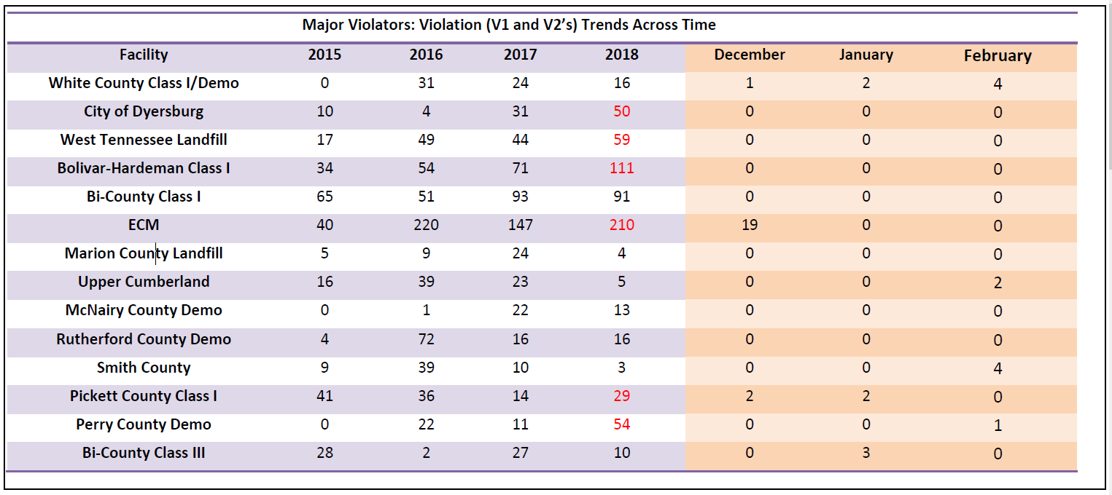
Major/Re-occurring Violators

Slide 6
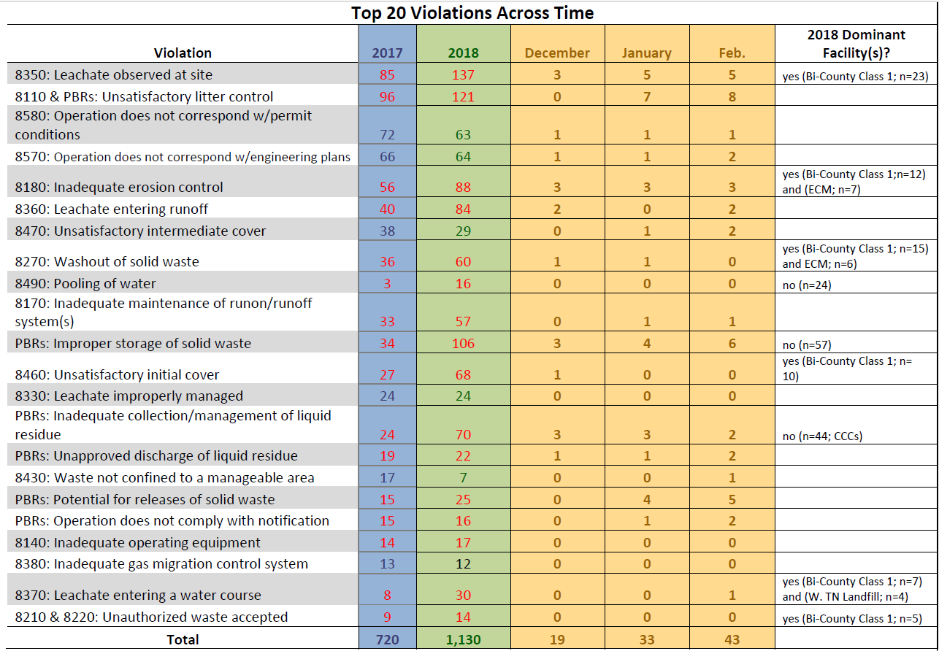
Major Violations

Slide 7
Complaint Investigation by Year

Slide 8
2018 Compliant by EFO

Slide 9
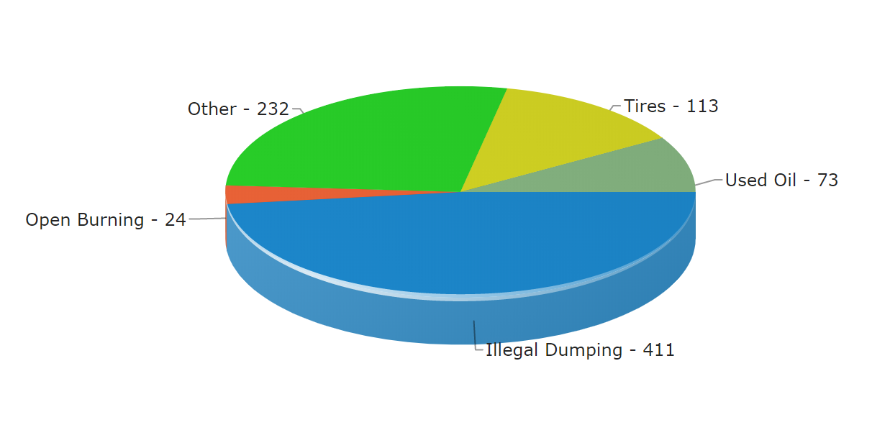
Compliant Topics
*137 of “Other” concerned “odors”

Slide 10
Program Updates-Special Waste
Improve overall process: eliminate confusion by ensuring DSWM and customers on same page
How to handle multiple disposal facilities?
Special Waste Facility Transfer Form
Add disposal facility to current permit
Request secondary disposal facility on new permit
One fee for two landfills (see below)
More than two landfills, additional fees necessary to cover costs
Provides record of each landfill used
Same basic fee structure
New: $300
Recertification: $150

Slide 11
Program Updates-Special Waste
Concluded Stakeholder Meetings in Middle/West/East Tennessee
Website Update
New Form(s) based on Stakeholder Input
Should be enacted by the time you see this presentation?

Slide 12
Program Updates –Continued Work on Rules/Policy and Guidance
Took a pause on new policy and guidance with administration change
New Rules should be in place by 2020
Exemptions For Recovered Material Processing Facilities
Periodic Landfill Engineering Reports
10-Yr. Renewal of Closure/Post-Closure Plans
Language Strengthening Permit-By-Rule Authorizations
Housekeeping Measures to Fix Typos, Remove Outdated References, Unused Rules, and Contradictory Rules

Slide 13
Continued Standardization of Inspections and GW Analysis
Solid Waste – Statewide Uniform Inspector Training (SUIT)
Standardizing Inspection Process Across State
Includes Classroom Training and Field Co-Inspections
Have Developed Training for Stakeholders, too
Media Sampling Training
Led By Pat Mulligan in Knoxville EFO
Focus on GW, Surface Water, and Soil

Slide 14
Contact
Email: Nickolaus.Lytle@tn.gov
Phone: 615-532-8004
Fax: 615-532-0938
Mail: Division of Solid Waste Management William R. Snodgrass Tennessee Tower 312 Rosa L. Parks Avenue, 14th Floor Nashville, TN 37243

