Slide 1
2021-25 Outcomes-Based Funding Formula Review Committee
Meeting #2
September 1, 2021
1:30PM CDT
Notes:
Steven

Slide 2
Formula Review Committee
Welcome and Introductions
Agenda Overview
Review of July 8 Meeting

Slide 3
Discussion of Proposed Five-Year Revisions to Formula

Slide 4
Graduation Rate Outcome

Slide 5
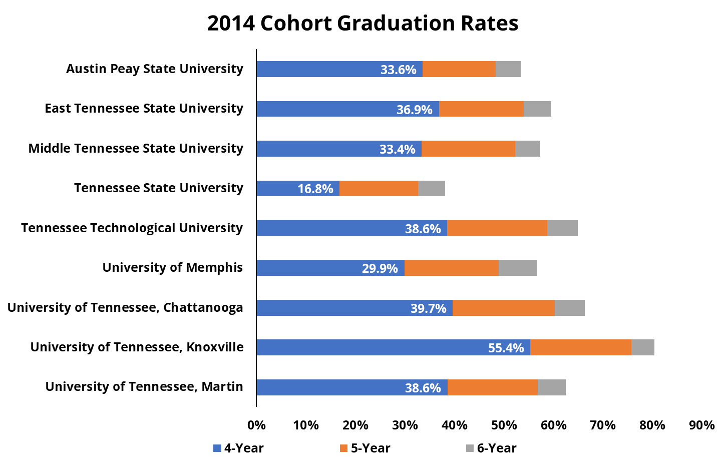
Graduation Rate Metric
53.5%
59.6%
57.4%
38.2%
65.0%
56.6%
66.3%
80.4%
62.6%

Slide 6
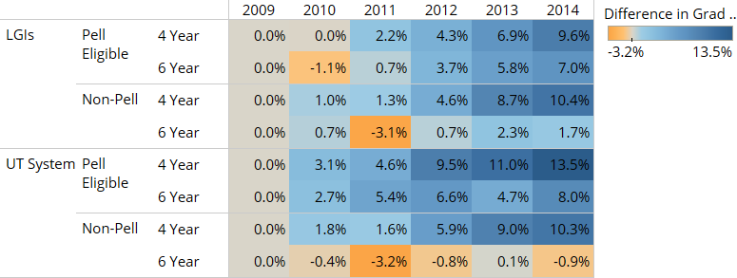
Pell and Non-Pell Graduation Rate Growth Higher at 4 Year Interval
Percentage Point Growth in Graduation Rate Since 2009 FTFT Cohort

Slide 7
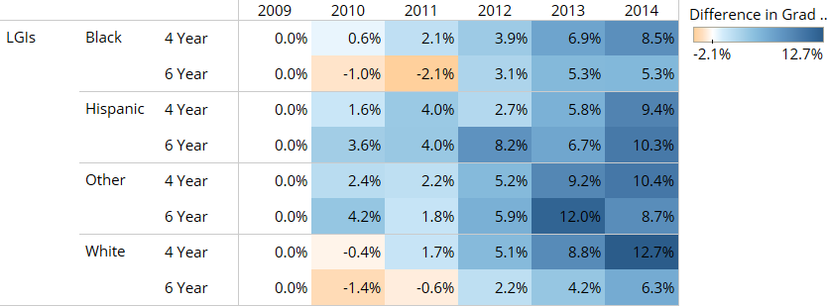
Graduation Rate Growth at LGIs Higher for Black, White, Other Students at 4 Year Level
Percentage Point Growth in Graduation Rates Since 2009 FTFT Cohort

Slide 8
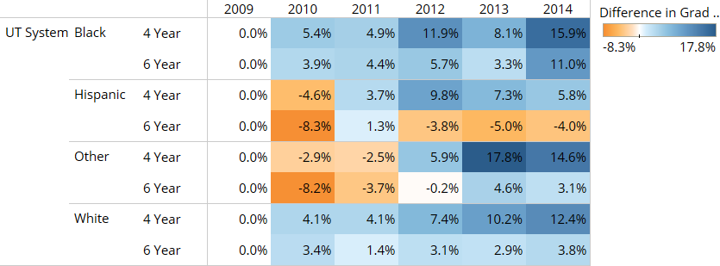
Graduation Rate Growth at UT Higher for All Groups at 4 Year Interval
Percentage Point Growth in Graduation Rates Since 2009 FTFT Cohort

Slide 9
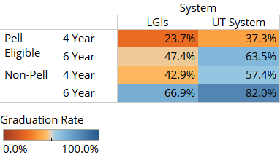
Room to Improve
2014 FTFT Cohort Graduation Rates, by Pell Status

Slide 10
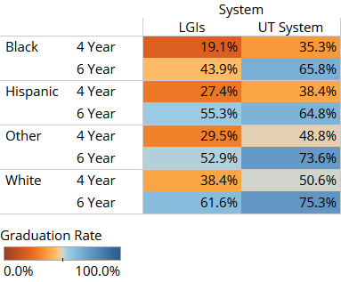
Room to Improve
2014 FTFT Cohort Graduation Rates, by Race/Ethnicity

Slide 11
Fixed Costs

Slide 12
Fixed Costs Review
Comprises ~22% of the overall formula
Measures
Education & General Square Footage
All E&G
Portables
20+ Years Old
Utility Estimate (based on national database)
Equipment Inventory
Rental Space
Annual calculation
Highly sensitive to new buildings/demolitions/renovations/off-line decisions
Most time intensive portion of formula

Slide 13
Why Address Fixed Costs?
Physical space is not an outcome enumerated in §49-7-202(f), the OBF founding statute
Yet, Fixed Costs as an “outcome” is the second biggest mover in the formula for both sectors
Only trailing associate and bachelor’s degrees
Inclusion of fixed costs in formula encourages institutions to expand campus footprint and not to reduce campus footprint
Yet, THEC capital process calls on institutions to be smart with capital investments
Maintain space in good condition
Maximize space utilization
Reduce unneeded/unused space
Number of institutions have recommended THEC revisit fixed costs

Slide 14
Reasons for Fixed Costs Movement
Reasons Increasing:
New Buildings at Nashville State, Northeast, Motlow, and Volunteer
Transfer of Cookeville Higher Education Center from TTU to Volunteer State (originated with Nashville State)
Acquisition of office buildings at UT Chattanooga
Reasons Decreasing:
Universities utilized space more efficiently in traditional E&G space rather than spread out in auxiliary space
Chattanooga State demolished buildings
Cleveland State added no new space
New Space offset with Demolitions (e.g. Northeast State)

Slide 15
Take Away
Current Fixed Costs structure encourage an arms race on space because the outcomes model rightfully encourages growth generally
The state—THEC, principally—calls on institutions to bring efficiency to capital space
Institutions that have practiced capital policies the state is encouraging moving forward have relatively lost funding over the years.

Slide 16
Fixed Cost THEC Staff Recommendation
Streamline the Measure
THEC Staff Recommended Proposed Change — Remove the nonrenovated premium, rent, and utilities from the measure, focusing squarely on E&G footprint and equipment inventory.
Restructure Fixed Cost to Limit Volatility
THEC Staff Recommended Proposed Change — Move the Fixed Cost measure from a one-year snapshot of data to a three-year average.
Reduce Fixed Cost Influence on Formula
THEC Staff Recommended Proposed Change — Gradually reduce, not remove—over three formula cycles—the influence of Fixed Costs on the formula.

Slide 17
Workforce Training Outcome
Notes:
Steven

Slide 18
Workforce Training Outcome
What is workforce training?
Non-credit activities that increase occupational, technical and/or soft skills in the workforce.
What is included in the workforce training metric?
Activities offered under contract with local businesses or municipalities
Activities and programs open to the community
What are the current concerns?
Partnerships with third-party online providers
Reporting activities by secondary trainers

Slide 19
Workforce Training Outcome
Removal of Ed2Go and trainer-provided activities
THEC Staff Recommended Proposed Change — Refine data definition to exclude activities provided by third-party vendor Ed2Go and activities independently provided by trainers who received their training from the reporting community college.

Slide 20
2021-25 Outcomes-Based Funding Formula Review Committee
Meeting #2
September 1, 2021
1:30PM CDT

