Slide 1
Freight Advisory Committee
November 1, 2023
Dan Pallme, Asst Chief of Freight

Slide 2
Safety
Year to date (through 10-31-23)
  1, 126 fatalities on Tennessee Roadways vs 1,105 last year
  149 large truck fatalities vs 139
334 restrained vs 314 unrestrained – Buckle Up!
148 pedestrian vs 170 in 2022
These change every day so continue to make a difference

Slide 3
Current Freight Role at TDOT
Rail Safety - 5
Rail Engineering / Section 130 - 5
State Safety Oversight - 1
Freight Planning - 4
Short line RR grants
Federal grants
Multimodal: Transit and Bike / Ped Planning – 5 / 19
Passenger Rail - 0
  State Aid - 3
Local Programs – 17

Slide 4
Role at TDOT
  What do you focus on at the Department?
  ‘Right Freight on the Right Mode at the Right Time’

Slide 5
Freight Update in past 18 months : 2022 - 2023
Memphis Freight Flows - WSP
  Duplication of NEP Project – Completion 2022
Bottleneck Analysis: December 2022
Update to the Freight Plan – June 2023
Water Research Project: University of Memphis, 2023 - ongoing – Tentative workshop in February, 2024
Freight Advisory Committee – November 1, 2023
Finish BlueOval Transit Study – October 2023
ROI study – December, 2023

Slide 6
ROI Shortline Study – HDR
Keith Bucklew / Dean Prestegaard

Slide 7
Break
Dan Pallme, Asst Chief of Freight

Slide 8
Truck Parking Efforts
Dan Pallme, Asst Chief of Freight

Slide 9
Tennessee Truck Parking Issues / Oppty
National issue
Cost
No on ramp or off ramp parking: safety - 5 TDOT vehicles hit in October!
Competing interest for dollars
NIMBY
Federal grant opportunities
  MPDG in Smith County – 125 truck parking spaces
  Data driven

Slide 10
Tennessee Truck Parking
Background of truck parking study efforts
  Ramp truck Parking – June 2017
  Tennessee Smart Park – December 2017
  Truck Parking Needs – November 2020
Current Project - HNTB – Completion by March, 2023
  Top 20 sites
  Low hanging fruit
  Opportunities – excess land, weigh stations, expansions

Slide 11
What’s on the Horizon?
Dan Pallme, Asst Chief of Freight

Slide 12
Tennessee Numbers
Growth = Congestion
  Tennessee – 10th cost of Congestion (8) - 11.1% increase
  Nashville Metro – 9th cost of Congestion (10)
  Timeline to success

Slide 13
What’s on the Horizon Freight
IIJA or BIL – More emphasis on leveraging $$$
Potential Water Program
Weigh in Motion – Full scale operation
ROI project / Case Studies – Ongoing – December 2023
Truck Parking Projects implemented
Passenger Rail Project studies – May 2023

Slide 14

TDOT Update
November 01, 2023

Slide 15






Anything New Happening at TDOT
A Little Organizational Initiative (EPIC & IPD)
A Little Transportation Bill
TMA
A Few New Federal Programs
A Little Extra Funding $3.3B
Notes:
We are fortunate to live in a state with so much going for us, direct results of our pro-business policies, high quality of life, and ranking as one of the lowest-taxed states in the country.
But Tennessee’s unprecedented growth presents challenges in our ability to move people, goods, and services more seamlessly across our state.
If we don’t do something – studies show commute times will increase by 60% and intercity travel times between major TN cities will increase by up to one hour.
We want to build a system for tomorrow and solve this in urban and rural communities. We want to build it now. And we want you to build with us.

Slide 16
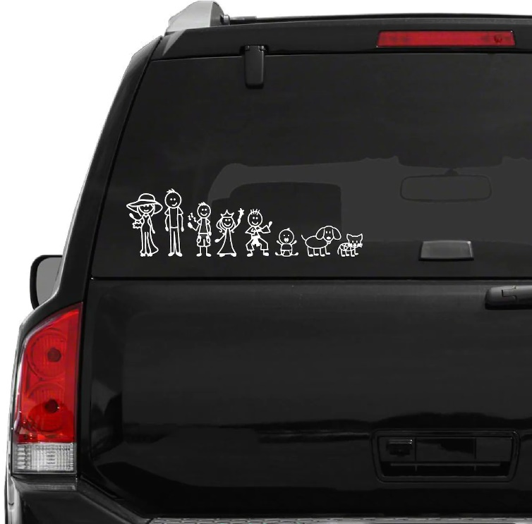


The Bureau of Environment & Planning
We Have Grown & More Changes are Coming
Environment
Long Range Planning
Freight & Logistics
Multimodal
Local Programs
Strategic Transportation Investments
Notes:
We are fortunate to live in a state with so much going for us, direct results of our pro-business policies, high quality of life, and ranking as one of the lowest-taxed states in the country.
But Tennessee’s unprecedented growth presents challenges in our ability to move people, goods, and services more seamlessly across our state.
If we don’t do something – studies show commute times will increase by 60% and intercity travel times between major TN cities will increase by up to one hour.
We want to build a system for tomorrow and solve this in urban and rural communities. We want to build it now. And we want you to build with us.

Slide 17
Environment

Slide 18


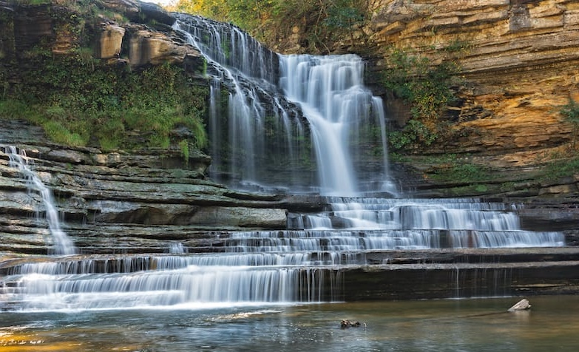
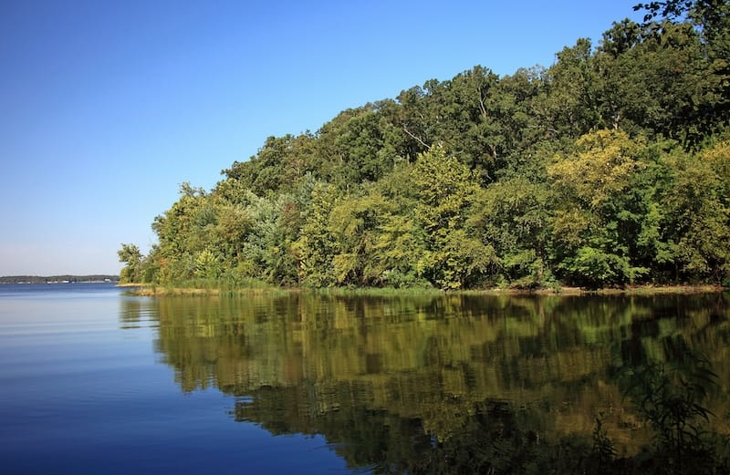
Highlights
EPIC
Environmental Services
Highway Beautification
Mitigation Market Research
Notes:
Environment
Alignment of Environmental Staff - Environmental staff in region were not part of the Environmental Division (now are – Part of EPIC)
Working with TDEC on mitigation market study
3 On-Call (all-inclusive NEPA contracts – CEC, RKK, JMT)

Slide 19
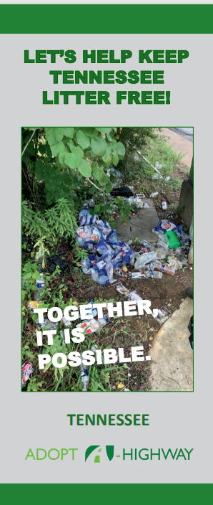


Highway Beautification

Slide 20
Long Range Planning

Slide 21
Highlights
Statewide Planning
Regional & Community
Planning
Research
Data & More

Slide 22
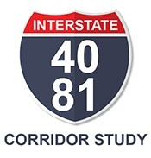
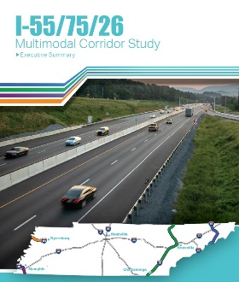
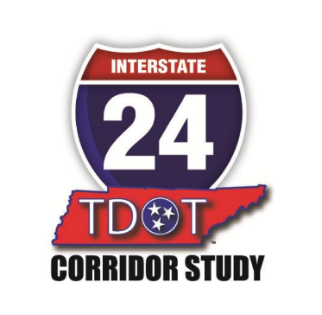
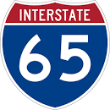

Planning & Data
Interstate Corridor Studies
2021
2020
2018
2014
Urban Congestion Studies
Started in 2019
December 2021

Slide 23
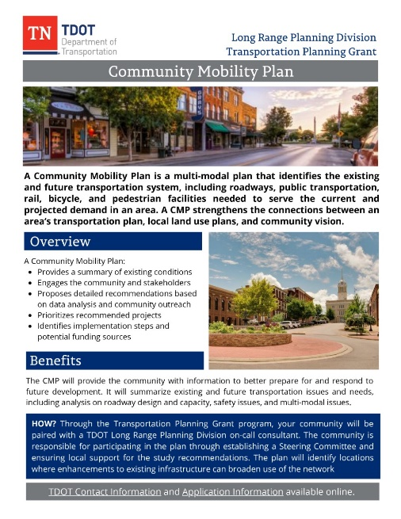
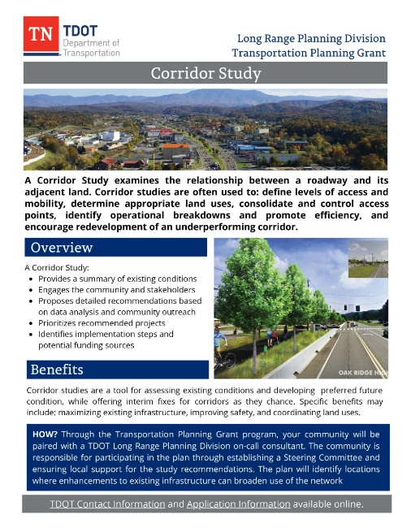
Regional & Community Planning
Community Transportation Planning Grants (CTPGs)
Urban Transportation Planning Grants (UTPGs)
Rural Regional Transportation Plans (RRTPs)
Corridor Management Agreements (CMAs)
Notes:
64 – CTPGs (17 bike/ped studies, 19 corridor studies, 13 mobility plans, and 3 complete streets studies)
11 – UTPGs (3 bike/ped studies, 4 corridor studies)
6 – RRTPs (6 out of 12 complete)
2 – CMAs (complete and a number of new ones under development)

Slide 24
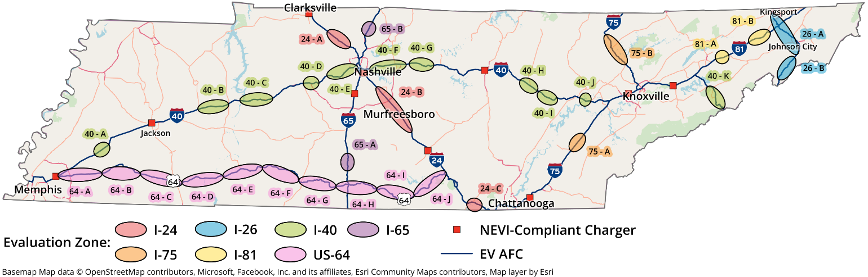
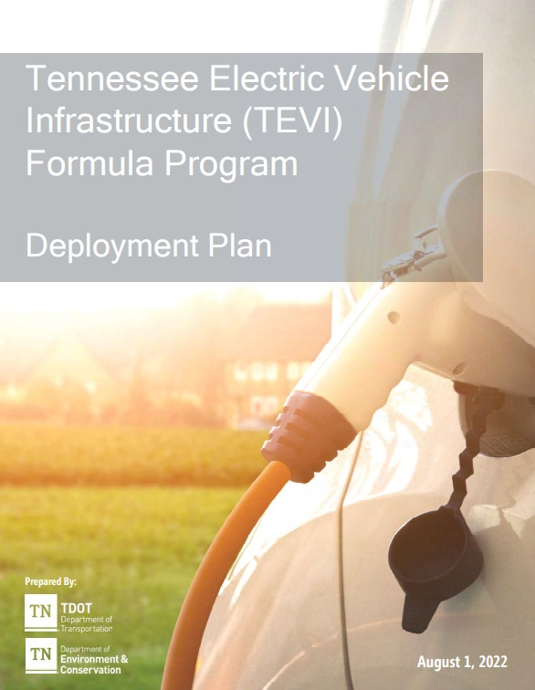
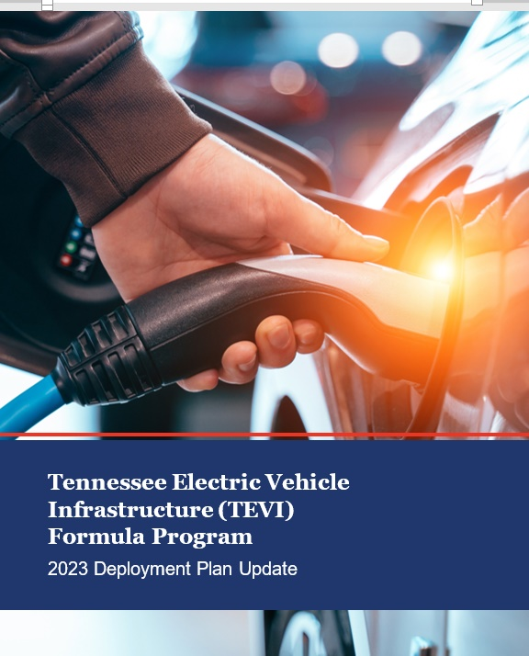
National Electric Vehicle Infrastructure (NEVI) Program
$7.5 billion in funding to expand electric vehicle (EV) charging across the US
    Formula Funding + 2 discretionary grant programs (Corridors & Communities)
Tennessee’s allocation is $88 million over the 5 years
Notes:
2 Plans since the passage of IIJA
1 Plan was developed in 2022
2 Plan due August 1st
Start Procurement in a month
32 zones
$18 million (24)

Slide 25
Carbon Reduction Program
Tennessee’s allocation is $139 million over the 5 years
Developing a Carbon Reduction Strategy – Nov 2023
Notes:
The CRP is providing $6.4 billion dollars in formula funding
for fiscal years 2022-2026. Tennessee’s portion of that
funding is approximately $139 million to reduce carbon
emissions.

Slide 26
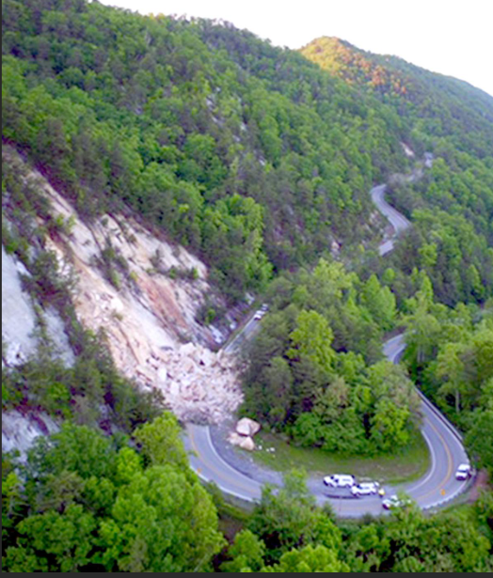
PROTECT Program
Promoting Resilient Operations for Transformative, Efficient, and Cost-saving Transportation
$8.7 billion Nationally, (FY2022 – FY2026) is comprised of:
$7.3 billion formula program (allocated to state DOT’s)
    $1.4 billion competitive, discretionary grant program
Tennessee’s allocation is $158 million over the 5 years
Developing a Resiliency Improvement Plan (RIP) – Nov 2023
Notes:
There is a federal requirement that 2% of our PROTECT funding
be used for resilience related planning. Over the life of the bill, just over
$3 Million (or around $600K annually)

Slide 27
Freight & Logistics

Slide 28
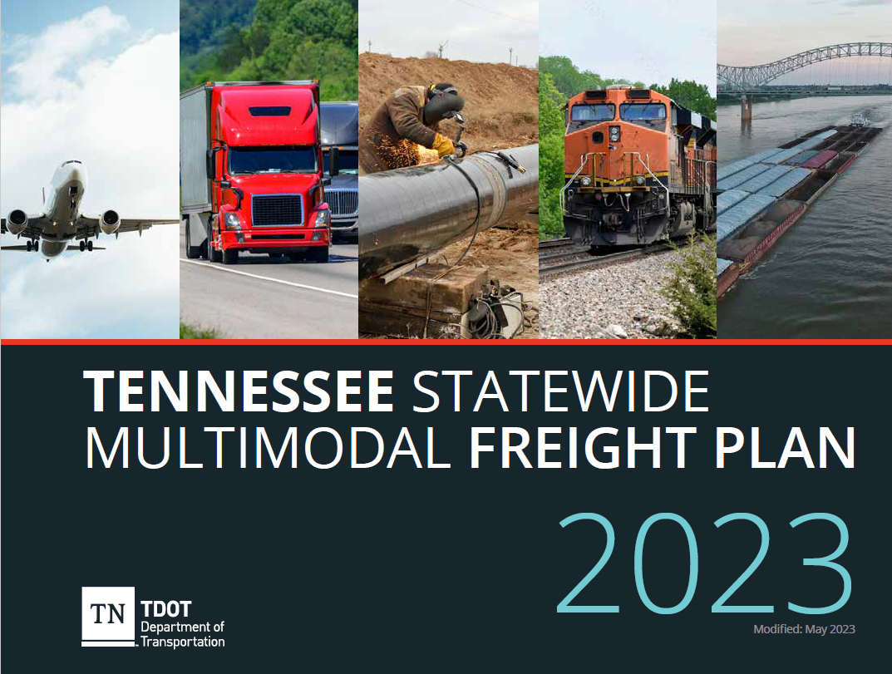
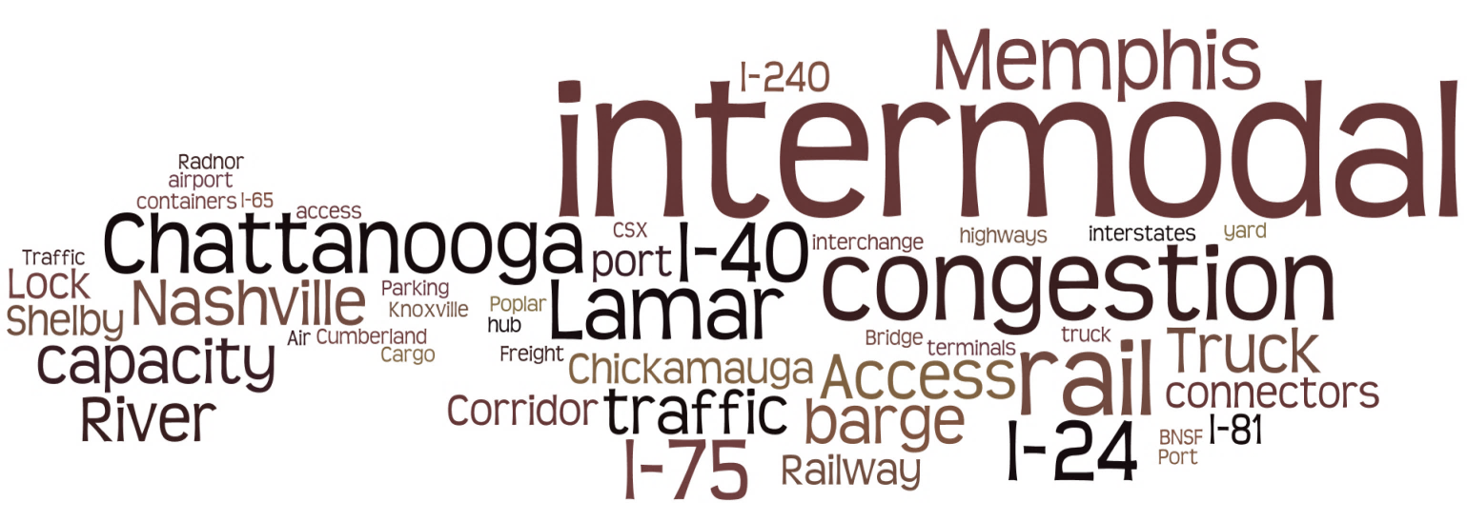
Statewide Freight Planning
Updated Freight Plan in June 2023
Working on Trucking Parking Study
Notes:
About $152 M in NHFP ($31 M annually)

Slide 29
Discretionary Grants
The Freight & Logistics Division has taken the lead on numerous federal discretionary grants over the years.
INFRA | RAISE | CRISI | RURAL
Over $280 Million since 2020
Notes:
Over $70M on 3 TDOT lead grants (I-40 Smith County Welcome Center Truck Parking $22M, FRA Shortline Bridge Bundel Project $23M)
Over $100M on city and county lead grants (Cleveland RR grade separation project $27M, Chattanooga Wilcox bridge $25M, Morristown SR 343 Complete Streets project $23M
Over $110M in transit grant funded projects (Memphis, Nashville, and Knoxville)
Leveraging Advanced Data to Deliver Multimodal Safety (LADDMS) Sensors Use LiDAR and camera technologies at key intersections to understand near misses in Nashville
3rd St SE and Norfolk Southern Railroad Grade Separation
U.S. Highway 127 Corridor Optimization
The Wilcox Boulevard Bridge - River to Ridge Mobility Project
SR 343 Complete Streets and ITS Traffic Signal Coordination Project
I-40 Truck Parking and Bridges Replacement
Hickman County - Countywide Bridge Planning Program
East-West Connector Corridor Plan
"An End-to-End Decision Support System for Integrated Smart Electric Grid and Transportation System Management"
Bridge to Bridge Corridor Master Plan
Charlotte Avenue/Dr. Martin L King, Jr Blvd Transit Headways and Congestion Management

Slide 30
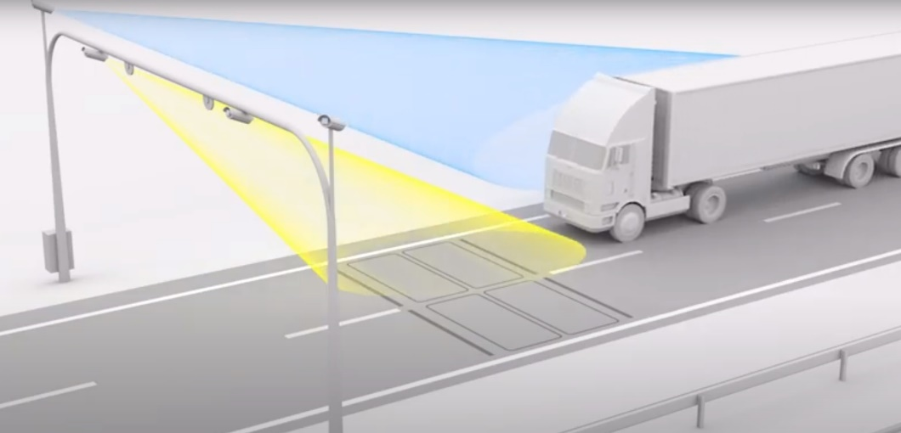
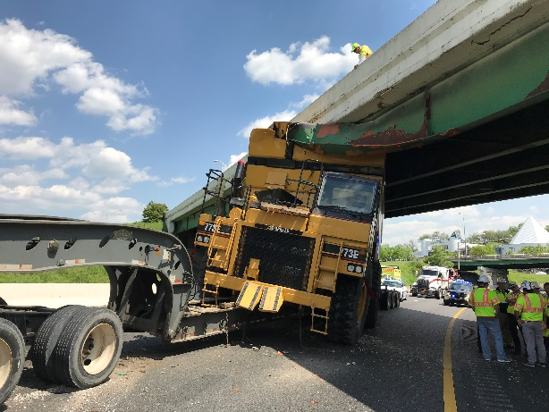
Statewide Weigh-in-Motion (WIM)
Preparing for Better Management of Freight Flows
Benefits
Enforcement
Safety
Data Collection
Asset Management
Accuracy of Design
TDOT is in the process of developing a statewide Weigh-in-Motion (WIM) program. WIM devices are designed to capture and record axle weights and gross vehicle weights as vehicles drive over a measurement site.
Notes:
Roadside equipment:
Weigh-in-Motion (WIM): Scales in the roadway that determine a vehicle’s size and weight
Overheight Detector: A camera that determines a vehicle’s height
Automatic Vehicle Identification (AVI): Identifies the vehicle by reading a transponder
Automated License Plate Readers (ALPR): Identifies the vehicle by reading the license plate
Changeable Message Signs (CMS): Allows customized notifications

Slide 31
Multimodal

Slide 32
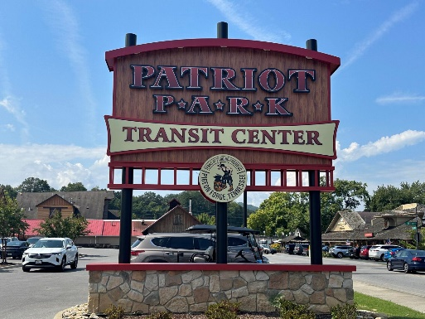
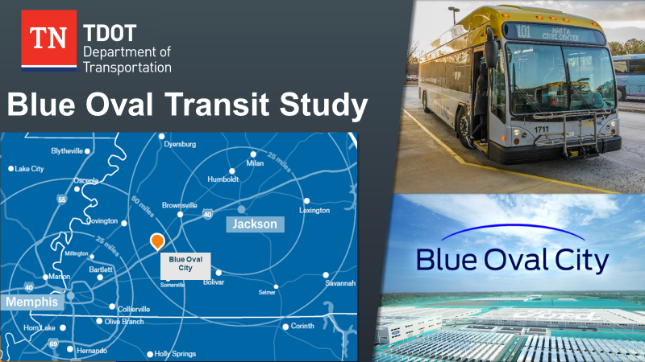
TDOT and Transit
Tennessee’s Transit Program
$77M
State transit funds
$200M
Approximate Annual Budget
IMPROVE Transit Capital Grant
$26M
Matches federal funding
Supports both urban and rural transit investments
New or replacement vehicles, bus stops and bus shelters, and maintenance facility improvements
Electric buses in Knoxville and a transit center in Pigeon Forge.
$30M
Operating assistance
$21M
Capital assistance
Notes:
TDOT’s role in public transportation is similar to most states.
Current law (which was passed in 2016) allows for transit public-private partnerships (P3s) to advance transit solutions
Federal funds come to the state based on a national formula (population, ridership, service area, etc.) and for the most these funds are largely pass-thru dollars
Of $85M, 80% (~$60M) of these funds go directly to the big 4 (Chattanooga, Knoxville, Memphis & Nashville)
20% (~$25M) of these funds go to TN’s small urban systems (Ex. Bristol, Clarksville, Cleveland, Jackson, Johnson City, Kingsport, Morristown, etc.). TDOT is a pass-thru on these funds and funds are distribute to these small urban systems based on a formula which is nearly identical to the federal distribution formula.
Since 2018 TDOT has awarded over $70 million in state funding through the Department’s IMPROVE Transit Capital Grant Program. TDOT also has other non-transit federal funding programs that the Department oversees and since 2020 has made over $40 million of federal funding available to transit investments in Tennessee that has supported transit operations, fleet expansion, and the conversion of buses to electric.

Slide 33
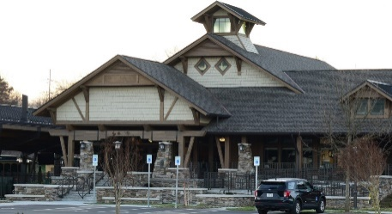
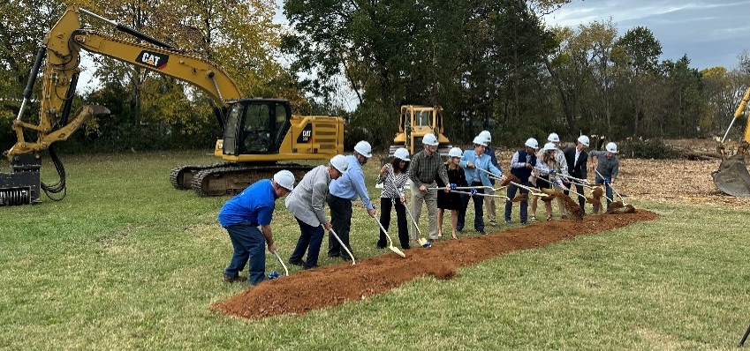
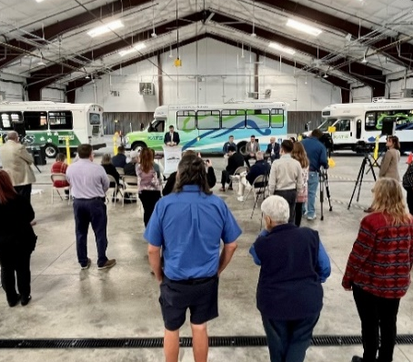
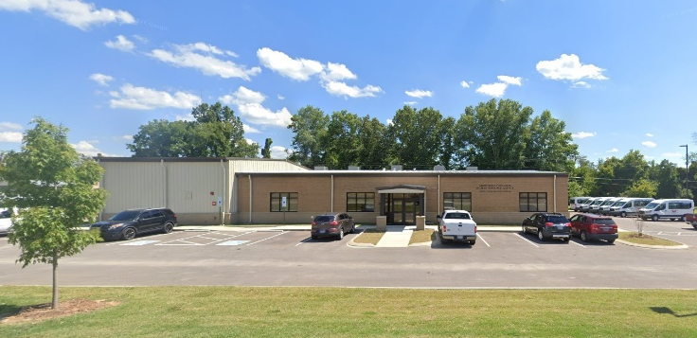


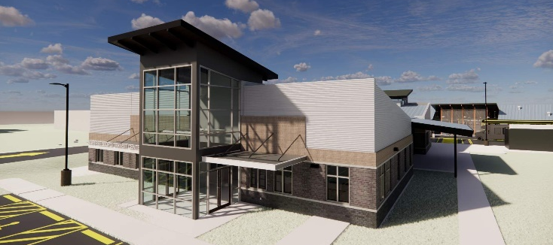
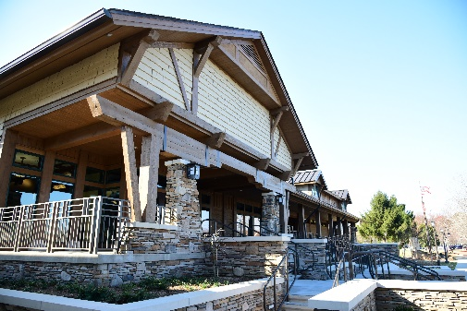
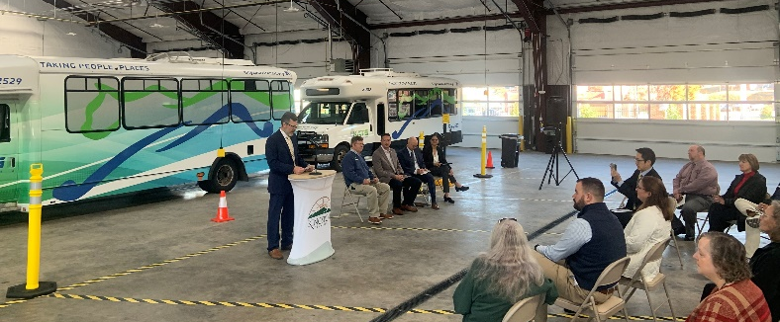
TDOT and Transit
6
TDOT’s
$88
=
new transit facilities
+
million investment
vehicles, stops, & system upgrades
Notes:
These monies are starting to pay off!
So far - TDOT’s $88 million investment has turned into six new transit facilities, the purchase of new transit vehicles, and improved transit stops.
In the last 5 years:
We have opened 3 new transit facilities
Northwest TN HRA Facility & Garage
Pigeon Forge Transit Center
Kingsport Transit Center & Garage
We have had 3 groundbreakings
Murfreesboro Transit Center
Hickory Hollow (Antioch) Transit Center
North Nashville Transit Center (ribbon cutting in Spring 2024)

Slide 34
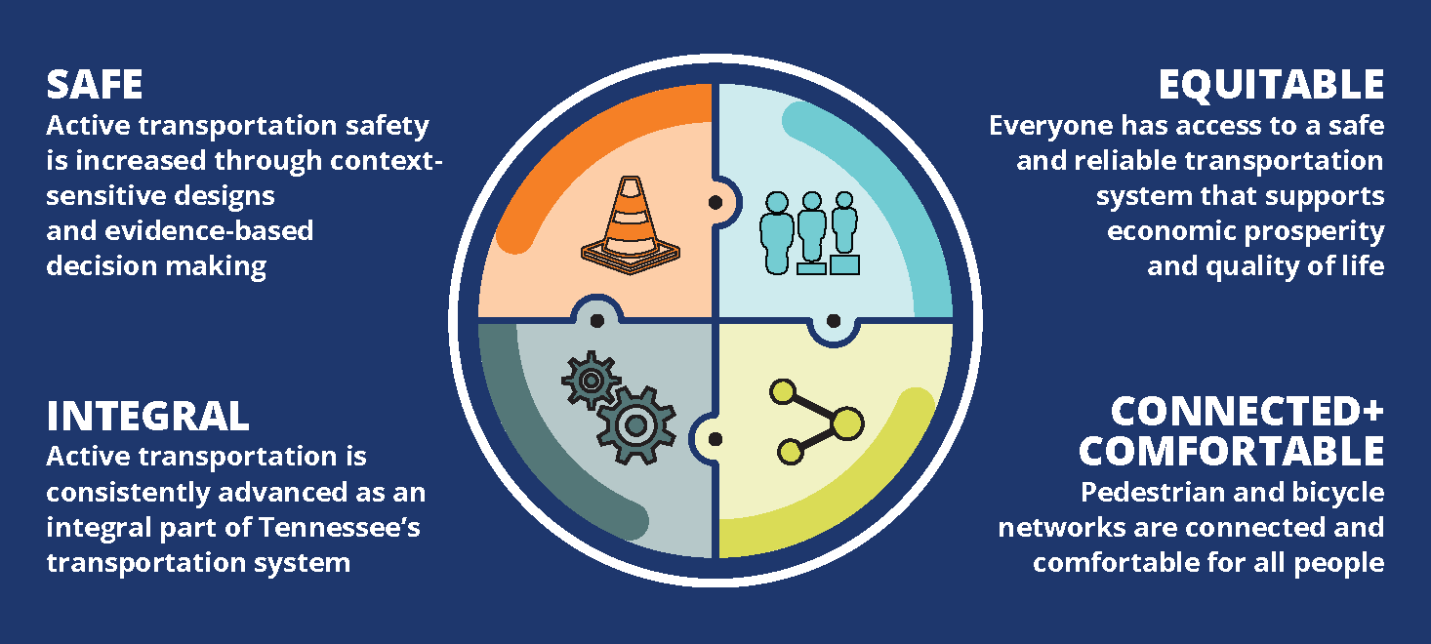
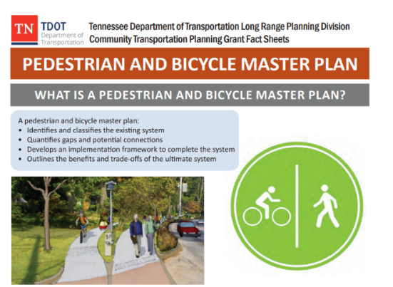
Greater Emphasis in Non-Motorized Safety
Multimodal Access Grant (MMAG)
Pedestrian Road Safety Initiative (PRSI)
Infrastructure Design Updates
Project Planning and Delivery
Statewide Active Transportation Plan
Research and other plans and projects
$18 Million
2 Yrs| 33 PRSI | 2 Let
Notes:
64 – CTPGs (17 bike/ped studies, 19 corridor studies, 13 mobility plans, and 3 complete streets studies)
11 – UTPGs (3 bike/ped studies, 4 corridor studies)
6 – RRTPs (6 out of 12 complete)
2 – CMAs (complete and a number of new ones under development)

Slide 35
Local Programs
Notes:
Currently over 500 active projects being administered by the Local Programs Division

Slide 36

Big Things Coming

Slide 37
Strategic Transportation Investments (STID)

Slide 38

STID Successes
Play an active role is linking the purpose and need of a project
  Transportation Investment Reports
  Concept Reports
  IARs
Safety Program
  50 to 80 Safety Projects | $40 M+ annually
  Over 100 RSA Projects (2018 – 2021)
  AASHTOWare Safety
SIA & Economic Projects

Slide 39
Next Steps
Dan Pallme, Asst Chief of Freight

