Slide 1
AIRPORT NAME
PRESENTER’S NAME
PRESENTER’S TITLE
Airport Logo Here
Notes:
This is the TITLE SLIDE
This slide is used as an identifier and should be the first slide for every project you submit
Use whatever picture you feel identifies your airport
Once you set up this slide, it should be identical with every project you submit
If you would like, TDOT will provide an aerial photo of your airport
Include your airport’s logo at the bottom right corner
This logo will be used throughout the slides
Please use the same logo for each page
If your airport does not have a logo, leave the logo block there and one will be created for you and emailed to you for future use

Slide 2

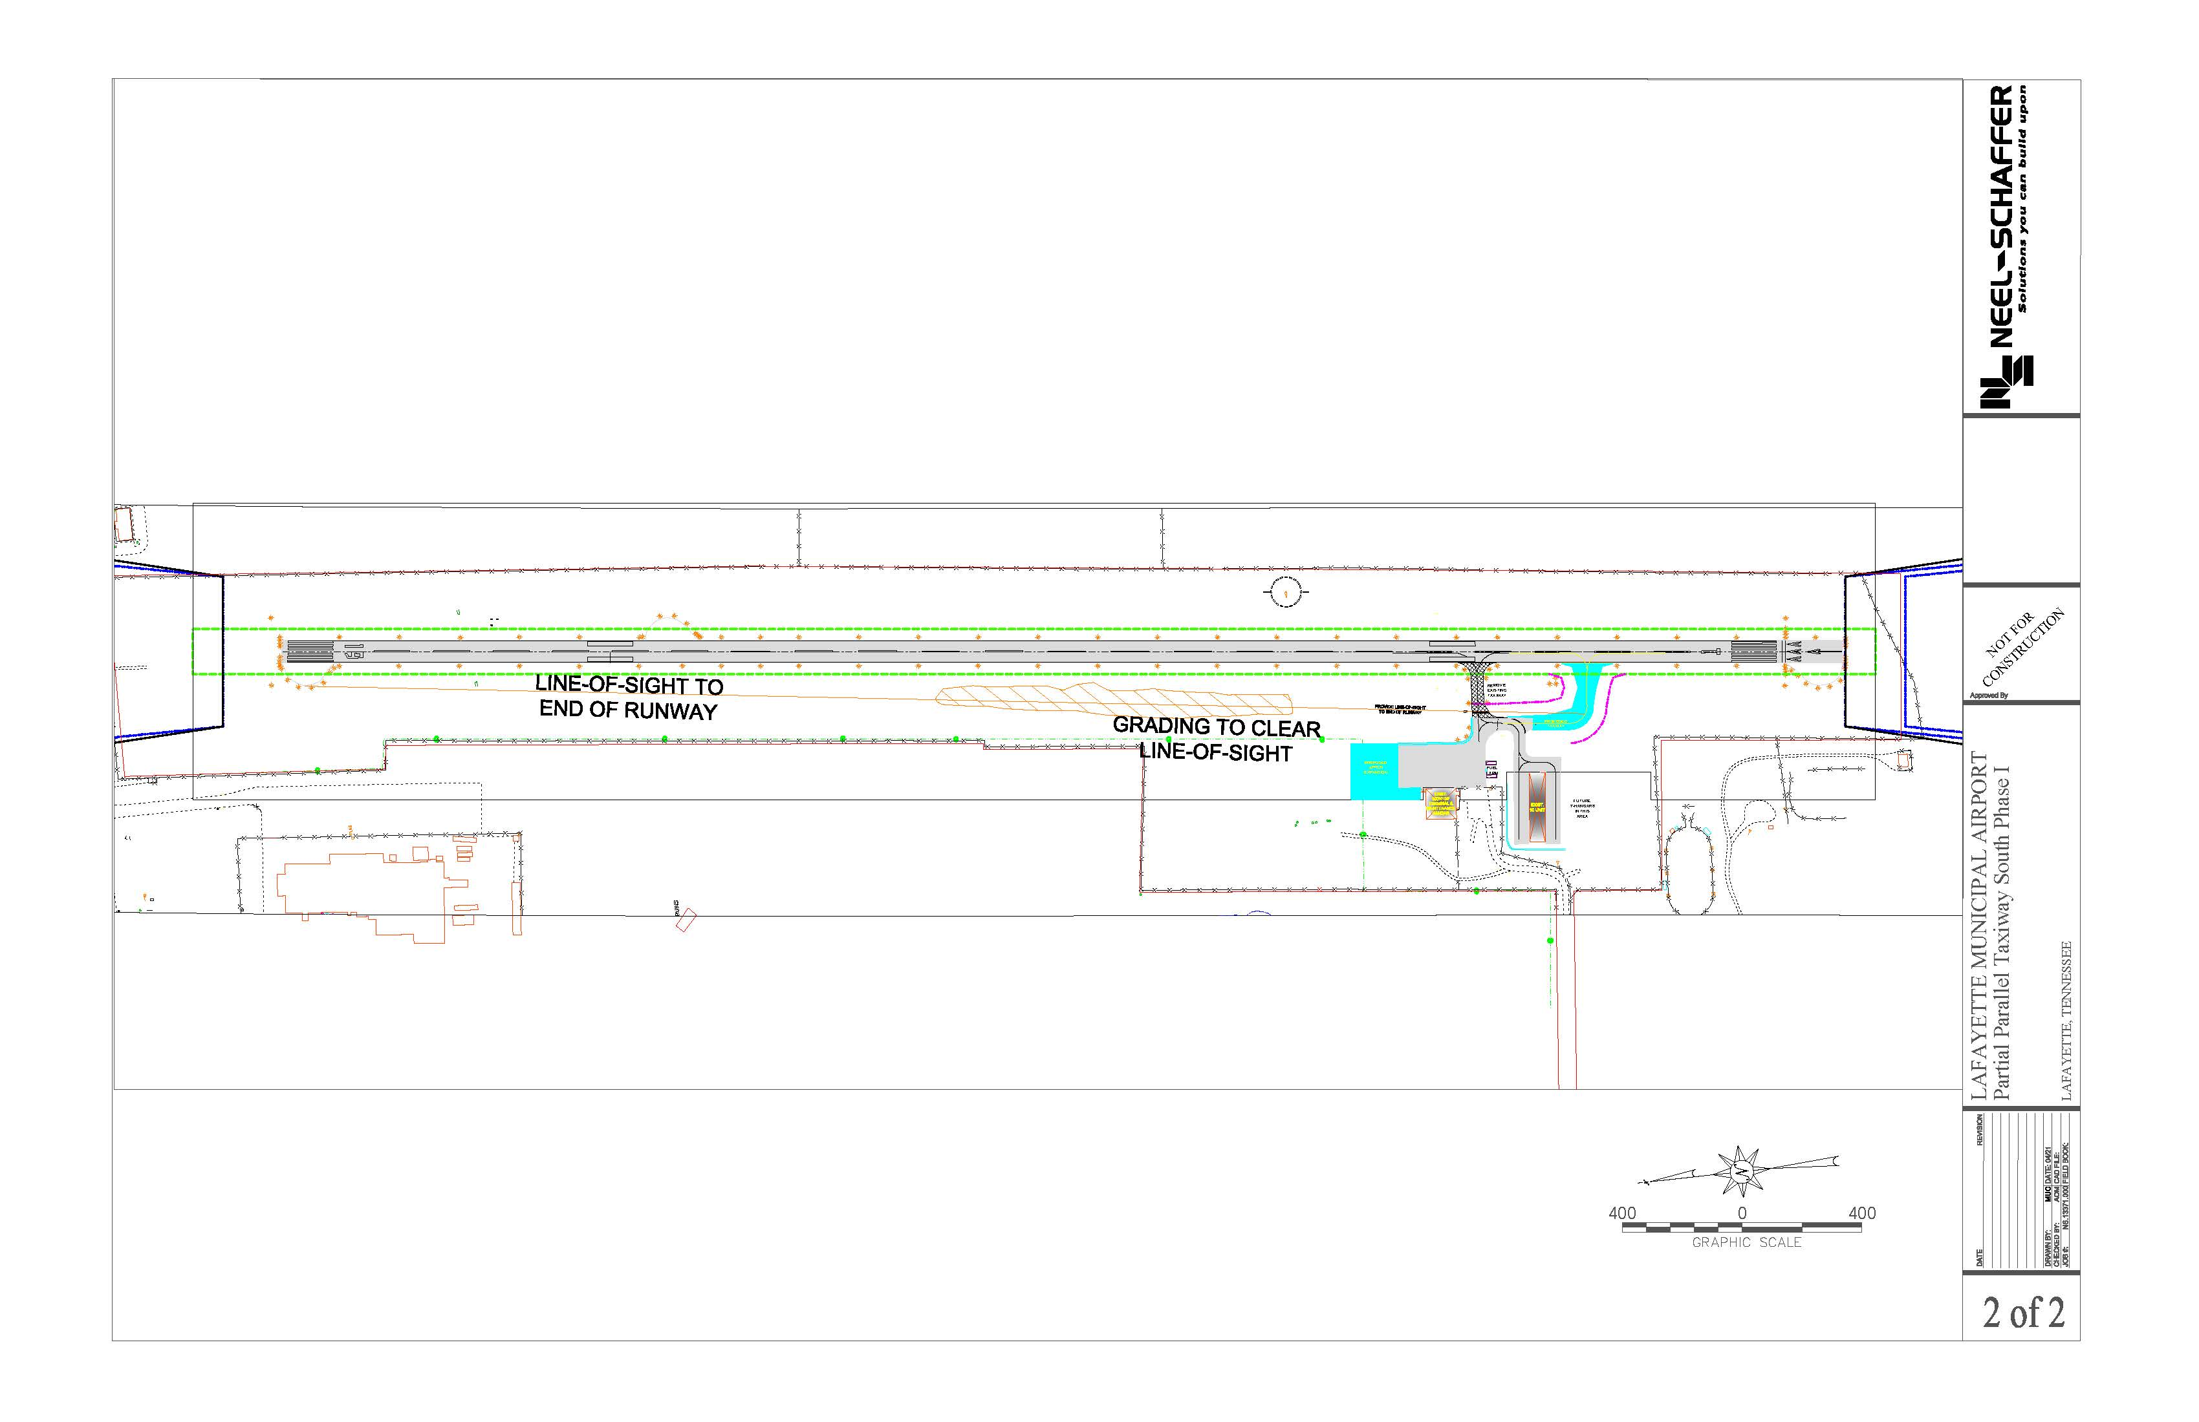
Project Scope
Airport Logo Here
Scope here
Scope here
Scope here
Scope here
Insert project schematics as needed!
Add additional slides, if required, to fully detail the scope of the project:
[Do not leave any instructions in your presentation!]
Notes:
This is the PROJECT TITLE slide
Please replace the words “Project Title” with the title of your project
Find a picture representation of your project and place it here. This can include location of project, CAD file, etc.
If you are unable to find a suitable picture please leave the existing picture in the slide and one can be provided for you
The airport’s logo should be in the top right corner of this slide
Do not hesitate to put multiple pictures/exhibits in the presentation

Slide 3
Project Title
Airport Logo Here
Why is the project needed?
  [Do not leave the questions in your presentations]
    Use the bullet points provided in this format as needed.
What will the project consist of?
Where on the airport does the project take place?
If amendment explain why additional funds/scope of service are changing.
Notes:
This is the PROJECT SUMMARY SLIDE
Please answer the questions listed here for every project you submit
Be clear and concise
Use the bullet points as seen in this template
The airport’s logo should be in the top right corner of this slide

Slide 4
Opinion of Probable Construction Costs
Airport Logo Here
Insert Engineer’s Estimate of Probable Cost as applicable to the type of application. Please include and tabulate separately estimated Construction Engineering Inspections & Admin. Fees.

Slide 5
Engineering Cost Estimate
Airport Logo Here
ITEM | TOTAL COST
[Engineering Design] | $ 100,000
Other Items like sponsor advertisement reimbursement, etc. | $ 250.00
Total | $ 100,250.00
Note: Per FAA SOP 11.00, given AIP money is planned, an Independent Fee Estimate was completed, validating proposed fees are fair and reasonable.
Notes:
Base this off the draft work order or work authorization your engineering consultant provided you. Break this out in as many rows needed.

Slide 6
Project Schedule
Airport Logo Here
Insert project milestone schedule in line with applicable dates: https://www.tn.gov/tdot/aeronautics/planning.html
Task 1- | Month X, XXXX PSR/TAC Review/Approval
Task 2- | Month X, XXXX Grant Execution Completion
Task 3- | Month X, XXXX Design Kickoff
Task 4- | Month X, XXXX Design Completion
Task 5- | Month X, XXXX Grant Closeout
Notes:
Only use this if it is for a design funding request

Slide 7
Financial Breakdown
Airport Logo Here
Delete this after completing: Please round total to nearest $100, then split federal, state, and local.
Federal NPE Funds (0%): | $0
State Funds (0%): | $0
Local Funds (0%): | $0
Requested Amount: | $0
Note: All funding requests to be rounded to nearest $100.
Notes:
Please use this slide if the proposed project is a non-amendment request.
Denote “NPE” if the federal portion is non-primary entitlement dollars (NPE)
This is the FINANCIAL BREAKDOWN slide
The cost should be divided into Federal, State, and Local funding
A percentage of each type of funding should be included
The airport’s logo should be in the top right corner of this slide
This should always be the last slide of your project’s presentation

Slide 8
Financial Breakdown
Airport Logo Here
Delete this after completing: Please round total to nearest $100, then split federal, state, and local.
Federal NPE Funds (0%): | $0
Federal ARPA Funds (0%): | $0
State Funds (0%): | $0
Local Funds (0%): | $0
Requested Amount: | $0
Note: All funding requests to be rounded to nearest $100.
Notes:
Please use this slide if the proposed project is a non-amendment request.
Denote “NPE” if the federal portion is non-primary entitlement dollars (NPE)
This is the FINANCIAL BREAKDOWN slide
The cost should be divided into Federal, State, and Local funding
A percentage of each type of funding should be included
The airport’s logo should be in the top right corner of this slide
This should always be the last slide of your project’s presentation

Slide 9
Financial Breakdown
(Use this side only for amendments)
Airport Logo Here
Delete this after completing: Please round total to nearest $100, then split federal, state, and local.
Federal NPE Funds (0%): | $0
State Funds (95%): | $0
Local Funds (5%): | $0
Requested Amount: | $0
Note: All funding requests to be rounded to nearest $100.
*Current Grant Total: $360,000
*Total Project to Date: $710,000
Notes:
Please use this slide if the proposed project is an amendment to an existing grant.
Denote “NPE” if the federal portion is non-primary entitlement dollars (NPE)
This is the FINANCIAL BREAKDOWN slide
The cost should be divided into Federal, State, and Local funding
A percentage of each type of funding should be included
The airport’s logo should be in the top right corner of this slide
This should always be the last slide of your project’s presentation

