Slide 1
Cooperatives 101
Virtual Local Government Purchasing Forum
October 26, and 27, 2022
Michael Porter - Category Specialist, Technology
State of Tennessee Central Procurement Office

Slide 2
Learning Objectives
WHAT is a Cooperative?
WHY Use a Coop?
WHO can use a cooperative contract?
HOW to find and use a Cooperative

Slide 3
What is a Coop?

Slide 4
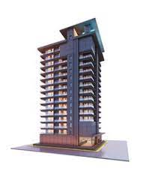
WHAT Types of Coop’s are there?
More than 250 Coop’s in United States in basically five categories:
Notes:
Brief Overview of the different types of Coops across the country
More than 250 Coop’s in United States in basically five categories:
Consumer – Credit Unions
Producer – Ocean Spray, Agriculture
Workers – Cab Companies
Housing – Condo’s Subdivisions
Purchasing – Private and Public ** Which would be US, the State and Locals

Slide 5
WHAT is Operating Model?
Public Non-Profits focused on States, Community Service –Local Governments, Schools.
Specialized/generalized focus
No-cost membership
Sign-up and use processes differ
Each individual state/local governments add their own unique procurement requirements
Designated/Voluntary Lead State or local Lead Government entity (A few use in-house people)
Competitive Solicitations
Notes:
MMCAP Specializes in Health related products
NASPO has State while OMNIA has Local Governments
All of these are always Competitive

Slide 6
Why Use a Coop?

Slide 7
WHY Use a Cooperative?
Shrink Solicitation Time
Grow Savings Sooner
Notes:
When there isn’t a Statewide Contract to “Piggy-Back” on
COOP’s offer an opportunity to
Save Time: solicitation cycle time
Save money: combined purchasing power/time to use
Provides flexibility to stay current

Slide 8
WHY Use the Following COOP’s?
Notes:
Many Users Across The State Both Local and State Level, Use These Coops:
Various Agencies within the State of TN
Tennessee Board of Regions: Various Colleges
University of Tennessee Systems
Austin Peay, General Services Administration
NASPO/Valuepoint: breadth of offerings/ Many in Technology
MMCAP infuse: Focused on Healthcare Services
Sourcewell: Ton of Choices - more than 60 Fleet and Fleet Related suppliers contracted
OMNIA: Protection from Hazardous Materials, which was more convenient for the State

Slide 9
State and COOP Contracts
Notes:
This shows the ratio between Coop Contracts to Statewide Contracts
*Remember this image is just the actual contracts not spend.

Slide 10
Who Uses Coops?

Slide 11
Who Can Use Cooperative Contracts?
Authorized Users may utilize statewide contracts by purchasing directly from the awarded Contractor(s) in accordance with their own procurement policies and procedures.
State Government
Departments & Agencies
Courts
Legislature
Commissions & Boards
Local Governments
Counties
Municipalities
School Districts
Quasi-Governmental Organizations
Higher Education
Universities
Community Colleges
TCATs
TN Private Nonprofit Universities
Qualifying Nonprofits
501(c)(3) organizations contracting with DIDD & MHSAS to serve citizens
TCA § 12-3-1205 & TCA § 12-3-512

Slide 12
How to Join

Slide 13
HOW Engaged is Tennessee?
15 Contracts: 39 local PA’s
5 Contracts: 185 engagements
1 Contract: 32 registered State and Local entities
1 Contract: 82 users
Notes:
State Gov, Local Gov, Higher Ed, Qualified Non-Profits
22 COOP Contracts
NASPO/Valuepoint: 15 Contracts and 39 local PA’s
MMCAP infuse: 5 Contracts 185 engagements
Sourcewell: 1 Contract, 32 registered State and Local entities
OMNIA Partners: 1 Contract 82 users

Slide 14
HOW to Join a COOP?
Each individual user must execute a PA for each contract/supplier they use
Each individual user must register, sign membership agreement, with MMCAP for an id, and set up an account with the supplier
Each individual user must register to receive an account number
Registration website-members agreement

Slide 15
NASPO
NASPO Contracts
SWC | SWC Description | Edison Contract | Suppliers
221 | Tires . | 62061, 62078, 63074,63095, 63466, 63469, 63470 | Bridgestone/Firestone, Goodyear, S&S Firestone, Tire World Southeastern, Truck Tire Center of Knoxville, Richard Goforth, Best One of Jackson
233 | SOW Projects | Confidential
380 | Small Package Delivery Services | 57269 | FedEx
419 | Mailroom Equipment, Maintenance, & Supplies | Confidential
423 | Radio Equipment, Maintenance, Repairs, Parts, Accessories, and Test Equipment | 73128, 73130 | JVCKenwood, BK Tech

Slide 16
NASPO Continued
NASPO Contracts
SWC | SWC Description | Edison Contract | Suppliers
563 | Laboratory Supplies | 49150 & 51339 | VWR, Fisher Scientific
3014 | Computers, Servers, Storage | Confidential
3020 | Cloud Managed Services* | 66265 | Delloitte
3021 | Comprehensive Cloud Solutions* | 67955, 67958, 67960 | Carahsoft, Insight, SHI
3030 | Data Communications | Confidential
3034 | Oracle Taleo Software* | 60862 | Oracle America Inc.
3999 | Software Value Added Reseller (SVAR) Services | 63087, 63066, 62925 | CDWG, SHI, Insight

Slide 17
NASPO Continued
Local Government, Higher Ed, Other Qualified Entities, and/or Single State Agency Use Only – No SWC
NASPO Contracts
Description | Edison Contract | Suppliers
Body Armor & Ballistic Resistant Products | N/A | Point Blank Enterprises, LLC
Electronic Monitoring | N/A | Satellite Tracking of People, LLC
Cloud Solutions – SaaS Networking | N/A | Centurylink dba Lumen

Slide 18
MMCAP Infuse
MMCAP
SWC | SWC Description | Edison Contract | Suppliers
440 | Medical Supplies | 61088, 61335, 63982 | cKesson Henry McKesson Henry, Schein, Medical Solutions
529 | Pharmaceutical Return Processing and Reverse Distribution and Destruction Services | 61673 | Inmar Rx Solutions
530 | Pharmaceutical Products | 64726 | Cardinal Health
531 | Birth Control Devices i.e. Condoms | 61381, 61394, 61395 | B Holding Group, Global Protection Corp, Lifestyles US Opco dba SXWELL USA, LLC
533 | Influenza Vaccine | 60744, 65915 | Sanofi Pasteur, FFF Enterprises

Slide 19
Sourcewell and OMNIA partners
Sourcewell Contracts
SWC | SWC Description | Edison Contract | Suppliers
204 | Vehicle&Equip Parts,Lt & Hvy Duty | *71921 | Genuine Parts Company (NAPA)
*72620, 72604, 72825, 72606, 72757, 72827, 72824, 72801, 72879, 72896, 73047
OMNIA Partners Contracts
SWC | SWC Description | Edison Contract | Supplier
564 | Emergency Preparedness | 65243 | Safeware
Notes:
Please note: there may be some instances where there isn’t a SWC for the NASPO you want to use but an Agency may have one their utilizing that you can “Piggy-back” onto.

Slide 20
How to Purchase
2 Days
Notes:
So… How long does it take to Join?
Just a couple of days. Depending on your internal processes you can join a Coop within days, which is a huge time saver!

Slide 21
HOW to Purchase
3 Ways to Purchase
Direct Purchase
Authorized Dealer
Company and Dealer Owned
Notes:
Resellers, Dealers, and Company Owned
SWC directly with company or companies only
SWC204 Vehicle Parts Company Stores and Dealer
SWC with Authorized Dealer Network but not with their sub-contractors or the companies that are under them
SWC 424 Radios Direct and Dealer
SWC directly with Company and directly with their Dealer Network as well
SWC 423 Radio Dealer Only
Not all of a Companies dealers will be contracted by the State.
Example1: Tire Company Stores under Master contract and only a select few Dealers are contracted
Example 2: Dealers are not contracted but honor the SWC
T’s & C’s and Pricing. Authorized Dealers listed on Usage Instructions

Slide 22
How to Find Coops

Slide 23
COOP Contracts
NEW

Slide 24
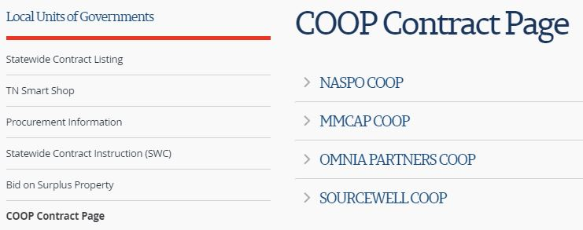
COOP Contract Lists
Each Dropdown has list of COOP’s Contracts that you click on

Slide 25
COOP Contracts – Select SWC

Slide 26
From COOP to SWC to Contracts

Slide 27
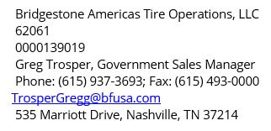
COOP Contract Info OR Usage Info
After finding the COOP you want go from COOP Contracts page go to Usage Instructions and click on the SWC

Slide 28
Recap

Slide 29
Recap
Notes:
The What:
- COOP’s that focus on Public Sector with History of
performance
The Why:
- The alternative when there isn’t a SWC- saving time, money and
provides flexibility
- Established relationships
The Who:
- Local Gov’s – no prior authorization is required
The How:
- A tidbit: Dealers and Contracts
- Several ways to find COOP Contracts—NEW Link

Slide 30
Questions

