Slide 1
Vehicle & Asset Management: Distribution of Surplus Property to Local Entities

Slide 2
What is the Surplus Property Program
General Services Surplus Property Program is the authority that determines how property purchased with state funding is disposed of after it is considered of no favorable use.
The program is designed to redistribute surplus from state agencies to other state agencies, city/ county governments, and eligible non-profit organizations.

Slide 3
What is Federal Excess/Surplus Property Program
The Department of General Services Federal Property Program is the authority and entry site for excess/ surplus federal property requested and approved donated after it is considered excess or surplus by the federal government
These programs are designed to reutilize federal excess or surplus property to States, law enforcement agencies, city/ county governments, and eligible non-profit organizations.

Slide 4
Types of Surplus or Excess Property
Computer & Related Equipment
Vehicles & Mechanical Equipment
Furniture
Office & Other Supplies (New/Excess)
Animals
State Waste Product (including scrap metal)
Anything purchased with state or federal funds

Slide 5
3 ways VAM Redistributes Surplus to Local Entities:
Resale of State surplus through Donee Participation
Donees can include, but are not limited to, city/county governments, school systems, law enforcement agencies, and approved non-profits.
Donees are defined by an application process that coincides with federal regulation.
Once a donee application is approved, all sales of surplus must be coordinated and administered through VAM’s surplus program.
Online Public Internet Auction of State surplus
If property has been stagnant for a specific period, and no interest in acquisition has been expressed by any donee, property is moved to the public internet auction.
Except where special circumstances exist, a new sale is posted every week.
DoD Section 1033 Excess Property Program
Approved eligible entities can screen for excess federal Department of Defense property suitable for law enforcement use at military bases or online.
VAM’s Law Enforcement Support Office (LESO) administers this program in partnership with Defense Logistics Agency (DLA)

Slide 6
State Surplus Timeline
Items Submitted by Property Officer & Received by VAM
1-5 Days
Available for Donee Sale
5-7 Days
Internet Auction
7 Days
Time to Pick-Up Items
10 Days from day payment is received.

Slide 7
State Surplus: How to Register as a Donee
Visit our website at https://www.tn.gov/generalservices/vam/state-surplus/forms-resources.html to download an application for eligibility.
Complete and return application and all other requested documentation to our office to be processed.
There is no charge for the donee application process. If you have any questions or need assistance in completing your eligibility package, please call us at 615-350-3376.

Slide 8
TN.gov > Department of General Services > VAM > State Surplus > Forms & Resources

Slide 9
State Surplus: Donee Responsibilities
The TN SASP will conduct reviews to ensure that donees are complying with the conditions and restrictions and are utilizing the property for the purpose for which it was donated. GSA requires that all items of donated property be placed into use within one (1) year of acquisition and used for a minimum of twelve (12) months.
The property acquired by the donee is on an “as is, where is” basis, without warranty of any kind. Donees will hold the Government harmless from any or all debts, liabilities, judgments, costs, demands, suits, actions, or claims of any nature arising from or incident to the donation of the property, its use, or final disposition.
Where a donee carries insurance against damages to or loss of property due to fire or other hazards, and where loss of or damage to donated property with unexpired terms, conditions, reservations or restrictions occurs, the State Agency will be entitled to reimbursement from the donee out of insurance proceeds of an amount equal to the unamortized portion of the fair value of the damaged or destroyed donated items

Slide 10
State Surplus: Public Internet Auction
When posting surplus for internet auction, VAM uses GovDeals.com.
To bid, you must register for a GovDeals account.
You do not have to be a donee to participate in public auctions.

Slide 11
Online auctions at govdeals.com/tnsurplus

Slide 12
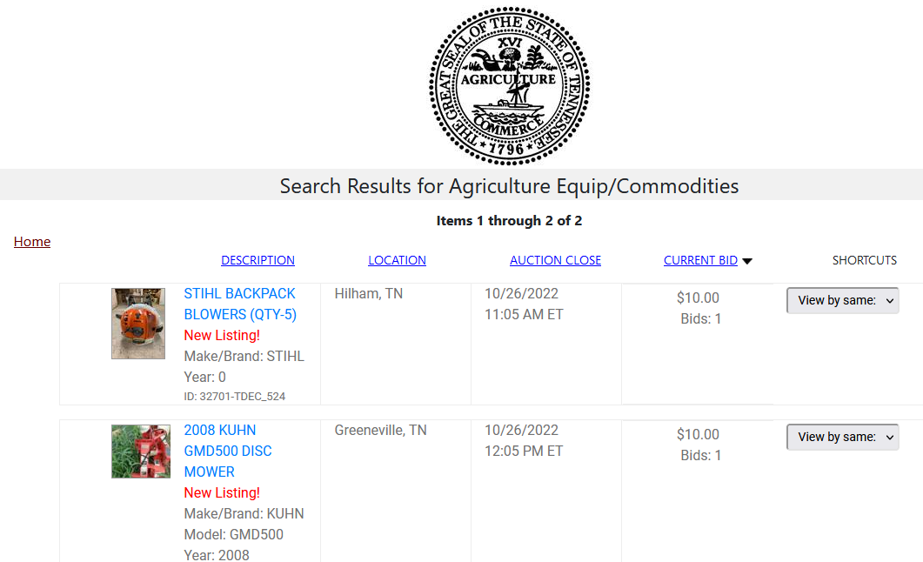
Online auctions at govdeals.com/tnsurplus

Slide 13
Law Enforcement Support Office (LESO)
VAM also administers the DoD Section 1033 Excess Property Program, through partnership with Defense Logistics Agency.
The program allows representatives to be eligible to screen for excess DoD property suitable for law enforcement use, in-person at military bases or online.
All DoD excess property can be used for counter-drug and other law enforcement activities, except operation of jails.
Eligible organizations may participate by paying a fee up to $1,000 and having a current State Plan of Operation (SPO) form completed and an application on file with the LESO Program Office.

Slide 14
Looking for Something?
Let us know the property you are looking for! Our inventory changes constantly. If we know the types of property you need, we can keep an eye out. This is especially true of more obscure equipment we would be less likely to keep in stock regularly.
VAM property staff will search for items of special need upon request.
Please complete a Wish List form on our website and email the completed form to surplus.scheduling@tn.gov
Wish list will be maintained by VAM Team and may be used to priorities criteria for allocating property.

Slide 15
VAM State Contacts
State Surplus Property Manager
Chris Douglas- Chris.Douglas@tn.gov – 615-350-3081
State Surplus Property Reps
Gary Ryan
Don Coffman
Darrell Chambliss
Nancy Weeks
James Thomas
Billy Farmer

Slide 16
VAM Federal Contacts
Federal Property Manager
Elbert Baker Elbert.Baker@tn.gov – 615-350-3321
Federal Program Points of Contacts
Walter Emery
Robert Dow
Joy Hendrickson
Andrea Jones
Tim Dailey
Pam Consolini

