Slide 1
PFAS Update
What is TDEC doing about PFAS?
PFAS Working Group | February 1, 2019
Notes:
What is PFAS: Per- and polyfluoroalkyl substances (PFAS) are a diverse group of compounds resistant to heat, water, and oil. For decades, they have been used in hundreds of industrial applications and consumer products such as carpeting, apparels, upholstery, food paper wrappings, fire-fighting foams and metal plating. There are more than 3000 manmade chemical chains or variations of PFAS.
PFAS Working Group has 12 TDEC Employees representing Air, Water, Waste, Remediation and 2 TDH members: It has been awesome to work with such talents across both Departments.
Group was established and met for the fist time in January last year. We meet monthly, and today you will see what we have worked on.

Slide 2
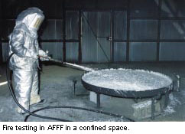
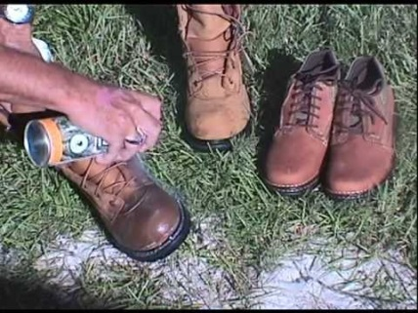
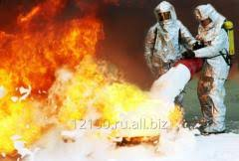
Where is PFAS?
Notes:
Dupont slogan: "Better Living Through Chemistry" PFAS uses include teflon coatings, food packaging, water repellents, stain resistant treated materials, personal care products dental floss, denture cleaners, shampoo, cosmetics , surfactants.
PFAS Chemicals are extraordinary persistent, meaning they don’t break down and have very strong bonds with long half-life. They accumulate in soil, water, food, and too often in our bodies. All of us have been exposed to PFAS Chemicals, but questions are being asked how much and what are we doing about it.

Slide 3
Unregulated Contaminant Monitoring Rule 3 UCMR 3 2013-2015
Monitoring included 6 of the 3000 PFAS Compounds
PFAS | Minimum Reporting level ng/L (ppt)
Perfluoroheptanoic acid (PFHpA, C7) | 10
Perfluorooctanoic acid (PFOA, C8) | 20
Perfluorononanoic acid (PFNA, C9) | 20
Perfluorobutanesulfonic acid (PFBS) | 90
Perfluorohexanesulfonic acid (PFHxS) | 30
Perfluorooctanesulfonic acid (PFOS) | 40
Notes:
Once every 5 years EPA is required to prescribe unregulated contaminant monitoring for public water systems to evaluate occurrence data. In the third round (UCMR3) and during the period of 2013-2015, 6 of the 3000 known PFAS substances were included for monitoring. Only approves EPA method 537.
Added 6 PFAS Chemicals to the Unregulated Contaminate Monitoring Rule in 2013-2015

Slide 4
Unregulated Contaminant Monitoring Rule 3 UCMR3 2013-2015
144 TN public water systems (total 470 ~ 30.6%) monitored for PFAs during this period
110 Surface Water Systems collected samples quarterly from each entry point for 1 year
23 Ground Water systems collected samples biannually from each entry point for 1 year
11 Groundwater Under Direct Influence (GWUDI) systems collected samples quarterly from each entry point for 1 year
A total of 652 samples were collected and analyzed for the 6 PFAS contaminants
Notes:
In TN there are 470 community water systems , 144 were selected to sample ~30.6%
Out of the 652 Samples taken at 144 TN public water systems, two Public Water Systems were found with PFAS contaminants.

Slide 5
PFAS in TN Prioritization Approach
Green- Low likelihood/probability of finding PFAS related chemicals in a specific industry
Example: Dry cleaning facilities
Yellow- Medium likelihood/probability of finding PFAS related chemicals in a specific industry
Example: Some landfills
Red- High likelihood/probability of finding PFAS related chemicals in a specific industry
Example: Air National Guard facilities
Notes:
Approach Determining PFAS Prevalence in TN
Workgroup members were asked to develop a list of potential PFAS industries in each region
Assistance from field office staff
Industries were identified as either potentially using or manufacturing PFAS chemicals
Brainstorming session to develop the most comprehensive list
Once list was developed, workgroup determined likelihood of presence of PFAS
Discussion with site PMs
Research of company and its products
Facilities producing carpet, textile, fabric, leather, paper or other products with stain resistant or waterproof properties
Facilities used for fire training operations using fire suppression foam
Facilities producing or using surfactants or wetting agents (used in agrichemicals, cleaning products and personal care products manufacturing)
Airports (especially those associated with military operations)
Metal plating operations
Military Bases
Chromium Electroplating Operations
Oil refineries/petrochemical facilities
Facilities producing Teflon or Teflon containing products
Aeronautical crash sites
Landfills, land application or disposal sites associated with the above
Major industrial chemical manufacturers

Slide 6
PFAS in TN Results
268 total sites were identified and evaluated
114 Low priority sites
101 Medium priority sites
53 High priority sites
Top high priority sites included:
Landfills
Fire fighting schools
Military bases
Airports
Chromium electroplating industries

Slide 7
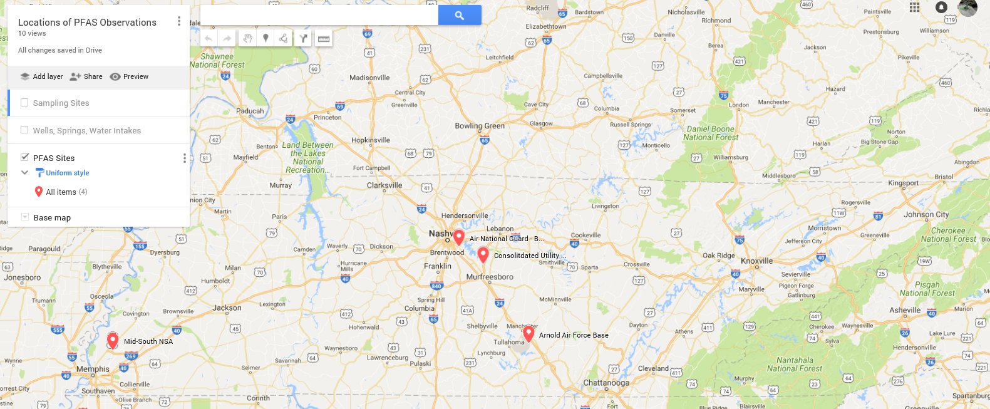
Locations of Confirmed PFAS Observations in TN
PFAS has been identified at four locations in the state:
Arnold Air Force Base
Air National Guard – Berry Hill
Consolidated Utility District of Rutherford County
Mid-South Naval Support Activity
Notes:
The map is a hyperlink, you can click it and it will take you to a Google Map version with additional layers.

Slide 8
What is the “number” and what is TN doing?
Standard/Guidance? What Study?
MCL, HA, SL, CL (Lau et al. 2006) (Butenhoff et al. 2002)
Potential DW Ranges
(11 ppt - 667 ppt)
Uncertainty? Exposure Parameters?
LOAEL to NOAEL Receptor, Ingestion rate, Body Weight
Sub-chronic to Chronic, Animal to Human Relative Source Contribution
TDEC involved on the current ITRC PFASs document
TDEC currently working with TDH to expand the workgroup and review available research
Notes:
We are part of the current (Interstate Technology and Regulatory Council) ITRC team and we are partnering with TDH to review research which may lead to our own “number” of some sort for something. You can see it is not exactly straight forward and depends on the standard/guidance, type of water, combined or individual, and some are not promulgated.
NOAEL and LOAEL Two terms often encountered are No Observed Adverse Effect Level (NOAEL) and Low Observed Adverse Effect Level (LOAEL).They are the actual data points from human clinical or experimental animal studies.
Remember there is only 1 approved Analytical method for samples, that is only for Drinking water. Currently there is no standard method for analyzing PFAS in surface water, non-potable groundwater, wastewater, or solids.
TDH has included a representatives to our PFAS group
Developing a chemical health related fact sheet and posting to their website (we can link back and forth with whatever we put up)
Develop a specific TN health advisor number but will refer to ATSDR publications
No calls thus far regarding PFAS, but are happy to be working with us to be prepared for if/when it does happen

Slide 9
TN Regulatory Authorities for PFAS
TN Safe Drinking Water ACT- provides authority to compel a Public Water Systems to monitor PFAS-
Possible funding for non Public Water Systems sources through State Revolving Funds and Ground Water Management Program
TN Clean Water Act – probable authority for monitoring under NPDES and Pre-treatment permits.
Special Waste Rule provides Division of Solid Waste Management authority to include PFAS parameters to characterize sludge and industrial waste streams before reaching Sanitary Landfills
TN Air Pollution Control Regulations give the Technical Secretary broad authority to require testing, or to conduct testing
Notes:
PWS = Public Water System
SRF = State Revolving Fund

Slide 10
PFAS Education & Outreach
Raise Awareness at TDEC Field Offices
Conduct Presentations on PFAS at TDEC Staff Meetings
Continue Monitoring EPA, ITRC, and State actions outside of TN
Correspond with Facilities/Industries that were identified as High Priority
Develop a Plan of Action for areas that pose a threat to Human Health and Environment
Continue interacting with TN Department of Health
Develop 1-pager/fact sheet explaining PFAS and TDEC efforts for response to public
Notes:
* Invite TDH to include a representative on our PFAS group
* We understand that TDH is working on chemical health related fact sheet and posting to a website (we would also like to have an interactive website)
* We understand that TDH will not develop a specific TN health advisor number but will refer to ATSDR publications
* Be prepares when/if TDEC/TDH receive calls regarding PFAS

Slide 11
What is TN doing?
TDEC has established an agency-wide, multidisciplinary work group and offers the following recommendations for next steps.
Inventory facilities and operations and identify sites that are high risk for impacts to environment
Develop recommendations for sampling programs appropriate for each media
NPDES discharges
Leachate
Groundwater
Drinking water intakes and wells
Potentially establish Health Advisory Level & Risk Assessment Levels
Create a internal webpage (GIS-capable) to help get information to the public and to create links for more information.

Slide 12
TDEC PFAS Website

Slide 13
What is PFAS?
Notes:
What is PFAS: Read Slide
Per- and polyfluoroalkyl substances (PFAS) are a diverse group of compounds resistant to heat, water, and oil. For decades, they have been used in hundreds of industrial applications and consumer products such as carpeting, apparels, upholstery, food paper wrappings, fire-fighting foams and metal plating. There are more than 3000 manmade chemical chains or variations of PFAS.
PFAS Working Group has 12 TDEC Employees representing Air, Water, Waste, Remediation and 2 TDH members: It has been awesome to work with such talents across both Departments.
Group was established and met for the fist time in January this year. We meet monthly, and today you will see what we have worked on.

Slide 14
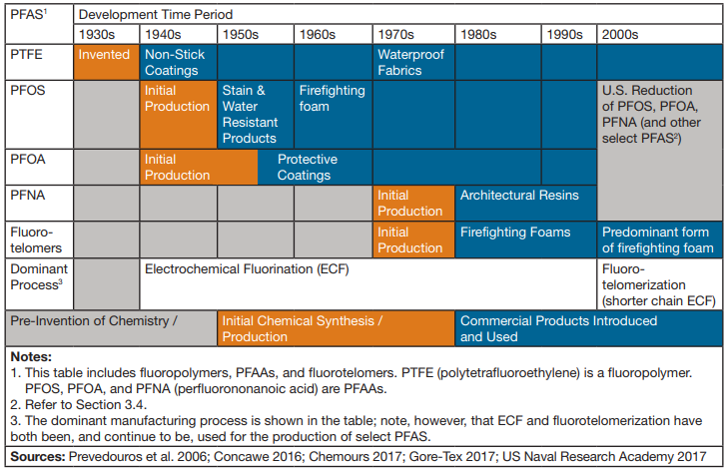
History and Use of PFAS
Notes:
First form PFAS is; PTFE (Teflon) was discovered by DuPont scientist in 1938 while developing new refrigerants. Subsequent product development included the stain resistant products, protective coatings, Aqueous Film Forming Foams (AFFF), etc and were widely used and introduced into commerce through 21st century

