Slide 1
Clinical Internship Self-Paced Training Course
Notes:
Introduction

Slide 2
Objectives
Articulate the policies and guidelines for the Clinical Internship course
Evaluate and apply concepts for student supervision in Health Science Clinical Internship experiences
Analyze the training requirements for Clinical Internship instructors
Formulate a course outline with dates aligned to the district calendar
Prioritize actions that ensure compliance with Tennessee Department of Education Work-Based Learning guidelines.

Slide 3
Recommendations for Self-Paced Training
Use the Clinical Internship Self-Paced Training Course one-pager linked here as a guide for completing this course.
Read through the entire course to get an overview of the content.
Work through the course referencing the online work-based learning (WBL) content as a supplement.
Complete the course test.
Note: The Clinical Internship teacher is responsible for following ALL of the WBL guidelines, and he/she must attend WBL training as required by the Tennessee Department of Education.

Slide 4
Table of Contents
Program
Description | Slides 6-7
Policies & Guidelines | Slides 9-10
Clinical Sites | Slides 11-13
Planning & Time Management | Slides 15-16
Parent Involvement & Documentation | Slides 18-19
Teacher
Requirements & Training | Slides 26-27
Student Supervision | Slides 28-29
Students
Readiness Policies | Slide 31
Placement Guidelines | Slide 32
Required Training | Slide 33-34

Slide 5
Program

Slide 6
Program: What is Clinical Internship?
Capstone course and work-based learning experience
Designed to provide students with real-world application of skills and knowledge obtained in a prerequisite Health Science course.
Prior to beginning work at a clinical site, students must be:
certified in Basic Life Support (BLS) Cardiopulmonary Resuscitation (CPR)
deemed competent in
basic first aid,
body mechanics,
Standard Precaution guidelines, and
confidentiality.

Slide 7
Program: What is Clinical Internship?
Upon completion of this course, proficient students will be able to pursue certification in the pre-requisite course of:
Cardiovascular Services,
Exercise Physiology,
Medical Therapeutics,
Dental Science, or
Pharmacological Science.

Slide 8
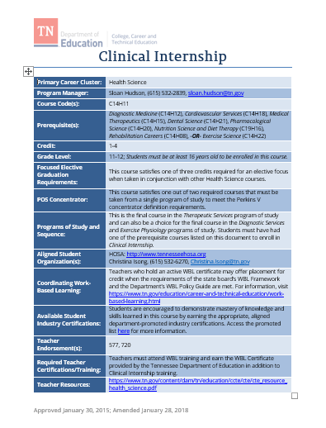
Program: Course Standards
Follow the Clinical Internship standards for teaching this course. Customize the standards as appropriate to align with clinical placements.
Arrange for clinical experiences that are aligned to each student’s program of study to facilitate the demonstration of knowledge and skills obtained by the student in his/her prerequisite Health Science course.
Arrange on-site clinical hours in accordance with the student’s best interest. The amount of time spent at the clinical site is determined by the teacher and district.

Slide 9
Program: Policy
Capstone WBL experiences and training must:
be aligned with the student’s area of elective focus and program of study (as required in state board high school policy),
equate to a full time equivalent credit,
meet the standards of the Career Practicum or Clinical Internship in which the student is enrolled, and
facilitate intentional progress toward the attainment of knowledge and skills necessary to pursue the student’s postsecondary and career goals.
Notes:
Are these the most current

Slide 10
Program: Basic Guidelines
The Clinical Internship teacher must follow ALL work-based learning policies as outlined on the Tennessee Department of Education website.
Clinical experiences must align with the student’s program of study. For example, a good placement for Exercise Science would be a physical therapy office while an inappropriate placement would be any EMS situation, medical laboratory or radiology.
The student to teacher ratio for the Clinical Internship course is 15 to 1.
Students must be 16 years of age to participate in Clinical Internship.
Rotation thru various departments at a hospital or stand-alone clinical site to observe employees providing direct patient care provides more opportunities for students to see various aspects of industry.
Clinical hours requirements are set by the district and school.
An active advisory board is important for your program:
Fifteen Steps to Developing and Sustaining Advisory Boards
and Program Partnerships
Experienced teachers recommend: Have a school policy for your program that is approved by your Director, Principal, and School Board.

Slide 11
Program: Finding Potential Placements
Begin securing placements for students during the semester before the Clinical Internship course is scheduled.
Reach out to personal contacts
Reach out to the industry advisory council
Set up a team of teachers, school counselors, CTE directors, administrators, etc. to research potential placements
Contact local postsecondary educational institutions for guidance
Ask other teachers and colleagues if they have a contact
Ask family and friends if they have a contact
Note: Some schools require the student to secure the placement, then the teacher follows up with the contact person the student designates.

Slide 12
Program: Communicating with Potential Placements
Invite potential partners to be a part of the decision making process regarding student placement via interviews, activities, calendars, etc.
Make phone calls to request meetings
Have an “elevator conversation” script prepared
Stress the opportunity presented by the program such as finding future employees, increased visibility in the community, access to free labor, and/or supporting students.
Invite partners to come and speak to classes
Design and send a recruitment letter to potential placements about your program
Sample recruitment letter
Include this one-pager to introduce WBL to potential placements
Plan a ‘meet and greet’ reception for potential site representatives. Have the students give a presentation on what they have been learning and what they hope to gain from their internship experiences followed by a time of fellowship where students talk with representatives and ask pre-planned questions.
Engage students in the clinical placement process.
Notes:
opportunities presented by program- chance to help train potential employees before they start, new employee pool, student can act as “employee extender” during rotation (answer phone, file, inner office errands, vitals) Gives the student a real view of the career they are wanting to do.
Found that face to face always works the best.

Slide 13
Program: Communicating with Potential Placements
Experienced teachers recommend: Consider creating a brochure to highlight the strengths of your program. Include this brochure in conversations and communications with potential industry partners.

Slide 14
Program: Sustaining Clinical Site Relationships
It is critical to maintain positive relationships with employers/clinical sites. Use the Principles for Sustaining Employer Partnerships one-pager for tips on nourishing relationships with clinical sites that support students.
This one-pager contains information on how to:
Individualize the relationship
Establish communication channels
Value the partner’s time
Specify goals and tasks
Value collegiality
Facilitate student interactions
Maintain flexibility
Anticipate trends
Express gratitude

Slide 15
Program: Mapping and Planning
Map out your semester/year with this online guide.
Keeps everyone on task
Completes the year with deadlines met
Provides greater potential for more student placements
Plan follow-ups and pop-ins which are vital to the program’s success.
Inform all placements about random monitoring visits
Work-Based Learning Student Placement Monitoring Visit Checklist
Provide feedback on students’ performance.
Student Skills Assessment Rubric
Ask a supervisor to complete an evaluation you provided.
Consider using a time management app to track student hours.
Notes:
***Supervisor eval of student - have a simple one that employers can just check off. If it is in depth and wordy they will not complete it. Online is even better

Slide 16
Program: Time Management
Recording student time is crucial, especially if Industry Certification is involved.
Attendance App Ideas:
Time Station
Time Sheet
Homebase
Freshbook
Harvest
Example
Notes:
Research other methods, some cost, some are free, has gps, make your own, etc

Slide 17
Program: Review and Revision
Take time to evaluate your program and make improvements where indicated. Use the linked evaluation framework templates to ensure the Clinical Internship course is relevant and sustainable with a particular focus on Tennessee Pathways and the belief that a progression of career awareness and skill development leads to student preparedness.
WBL SAMPLE Program Evaluation Framework 1
WBL SAMPLE Program Evaluation Framework 2
Notes:
Have Coordinators explain why advisor boards are great things to have.

Slide 18
Program: Parent Involvement
Sample document list:
Agreement of Schedule
Auto and Health Insurance
Clinical Rules
Confidentiality Agreement
Dress Code
Exposure Control Plan Acknowledgement
Flu Vaccine
Grading Policy
MMR and Hepatitis B vaccine
Physical and TB Form
Physician Physical Form
Universal Precautions Training Documentation
Experienced teachers recommend:
Have a parent meeting for disseminating information and signing documents.

Slide 19
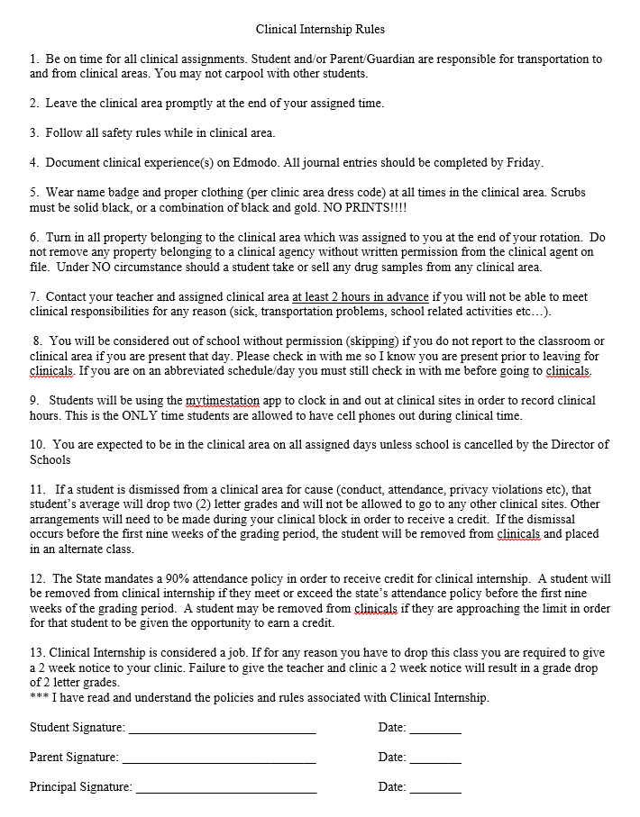
Program: Parent Involvement
Experienced teachers recommend:
Set forth expectations in writing
Involve school board, administration and parents
Clearly express consequences for non-compliance
Some districts have this document notarized when parents sign
Example

Slide 20
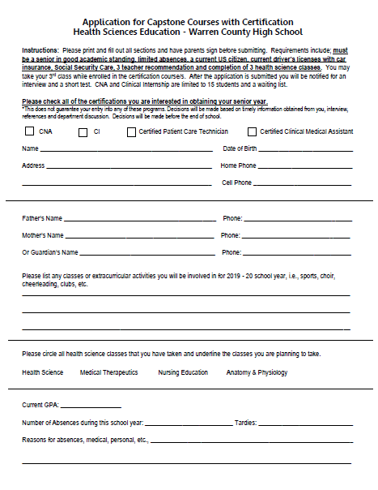
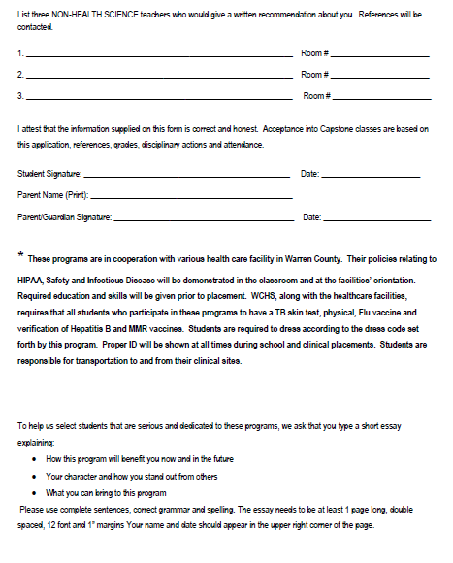
Program : Optional Application Process
Example
Experienced teachers recommend:
Work with your principal and school counselors to create an application process for the Clinical Internship class.
Example
Notes:
Lequita has an updated sheet
Need to explain the application process here.

Slide 21
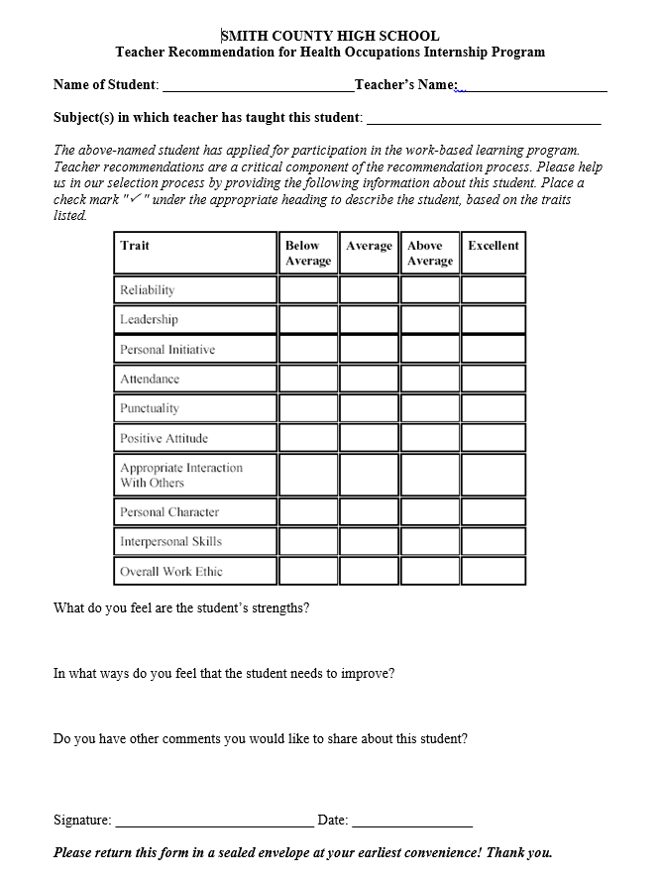
Program: Optional Teacher Recommendation
Experienced teachers recommend:
Include teacher recommendations in the application process
Complete anonymously
Minimum of 3
Return to Clinical Internship teacher
Follow up with an email or meeting
Review with school counselors and administration
Example

Slide 22
Program: Required Classroom Documentation
In addition to the required WBL documentation outlined in the WBL Policy Guide, the following documentation must also accompany any clinical internship student’s paperwork. There may be additional requirements from a given clinical site (such as orientation documentation), which would be in addition to the requirements below, if deemed necessary for a given placement. These documents should be kept in their original form at the school. Copies are appropriate for the clinical site.
Exposure Control Plan
There is not an official form for exposure control plans; however, a tool for covering exposures students may encounter can be found online at www.osha.gov.
OSHA Sample Exposure Control Plan
OSHA Blood-Borne Pathogens Exposure Control Plan
Note: All required documentation must be kept on record, secured for confidentiality, either in physical form or digitally for seven (7) years.

Slide 23
Program: Required Classroom Documentation, continued
Current Student Immunization Record
Up-to-date record of all immunizations
Hepatitis B (HBV) is required prior to placement for students expected to have patient contact.
Current Tuberculosis (TB) skin test results
Documentation of Current Student Physical (conducted within the past year)
Documentation of Student Insurance
Health insurance
If they drive a car, they must have car insurance.
Optional malpractice/liability insurance: Students may be given an opportunity for individual or blanket malpractice insurance through the school district.
NOTE: WBL students are not eligible for unemployment insurance.

Slide 24
Program: Required On Site Documentation
The following copies must be kept in each minor’s personnel file at the clinical site (should be in HR/administration):
Training Agreement
Safety Training Log
Insurance and Emergency Information Form
Proof of Age: the employer must maintain a copy of one of the following items for proof of age in each minor’s employee file:
Birth Certificate
Driver’s License
State issued ID card
Valid Passport
Statement of Oath from the Court
Optional additional items that may be included but are not required:
Proof of liability insurance
Vaccine record
Other items required by the clinical site
Confidentiality agreement
CPR card
OSHA 10 certification

Slide 25
Teacher

Slide 26
Teacher: Requirements
For placements that fall within the Health Science career clusters, a CTE teacher with the related endorsement must participate and provide adequate input on the following required WBL components:
the identification of safe work sites;
the approval of appropriate student goals as they relate to technical and academic application of skills within their area of expertise;
any Hazardous Occupation placements (as outlined in T.C.A. § 50-5-107);
the development of appropriate safety training plans and their delivery;
the conducting of at least one site visit per term; and
the review of portfolio products as appropriate.

Slide 27
Teacher: Training Requirements
To be eligible to teach the Clinical Internship course, teachers must complete the following training:
Online Clinical Internship Self-Paced Training Course
Work Based Learning training:
Work-based learning (WBL) is a proactive approach to bridging the gap between high school and high-demand, high-skill careers in Tennessee. Students build on classroom-based instruction to develop employability skills that prepare them for success in postsecondary education and future careers. The WBL Certification Networking Event addresses WBL Career Practicum and Clinical Internship standards, specific documentation and reporting requirements for students and teachers, WBL policies that apply to all CTE capstone courses, and strategies for launching or improving upon a quality WBL program.
Work-based learning training and recertification is offered three times per year. See the WBL website for dates and locations.

Slide 28
Teacher: Student Supervision
Only Health Science students supervised by teachers with Health Science endorsements are allowed in patient care areas. Health Science students MUST pass the universal precautions and HIPPA tests with a score of 100% BEFORE they will be allowed in any patient care areas.
Health Science students MAY NOT enter the patient care area with a Non-Health Science WBL coordinator. They may; however, participate in activities in the “front office”.
Note: A decision tree follows for further evaluation of student placement options.

Slide 29
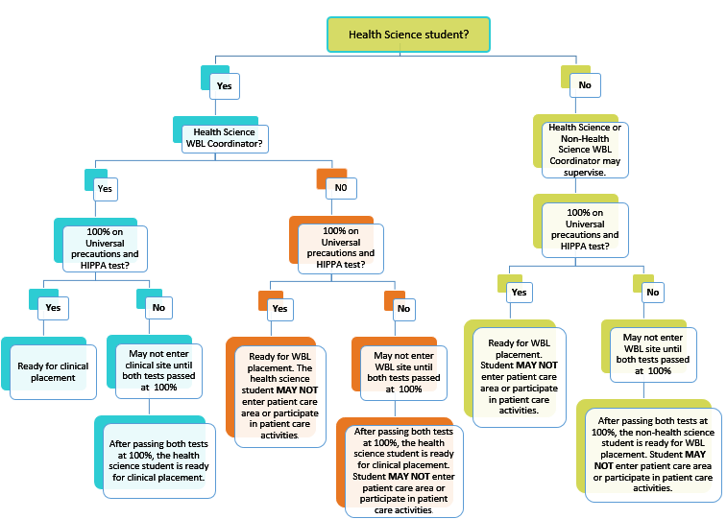
Teacher: Supervision Decision Tree

Slide 30
Student

Slide 31
Student: WBL Readiness Policies #6 and #36
In order to qualify for participation in the Clinical Internship course, students must meet student readiness expectations. An Employability Skills Checklist is available on the department’s WBL site. The minimum requirements for participation in a clinical placement are as follows:
The student should have successfully completed the aligned pre-requisite courses in his/her program of study.
The student should meet the readiness qualifications outlined on the employability skills checklist and must exhibit work readiness attitudes and skills as determined by the teacher and employer.
The clinical site administrator must approve the student and sign the work based learning agreement document .
WBL Policies:
Policy #6: Students must exhibit work readiness, attitudes, and skills as determined by the teacher and employer.
Policy #36: Demonstrated Readiness. Students must exhibit work readiness attitudes and skills as determined by the teacher and employer and consistent with the WBL Policy Guide before beginning a WBL experience. Interviews and/or pre-assessments may be used to determine a student’s readiness for a placement. Recommendations for assessing readiness skills may be found in the WBL Implementation Guide. (SBE High School Policy 2.103)

Slide 32
Student: Placement Guidelines
Students must meet eligibility requirements.
Clinical placements must align with each student’s program of study.
Students may only be placed in health-related jobs involving the care of patients when they provide evidence they have been HIPAA trained.
Students may not work in jobs in which blood-borne pathogens may be present unless they have been offered the hepatitis series injections and passed the Universal Precautions/Blood-borne Pathogens Test with 100 percent accuracy (OSHA Standards).
Students may only enter the patient care area when supervised by a Health Science endorsed teacher.
Students must maintain an attendance rate of 90% in school and in the WBL experience unless otherwise agreed upon prior to the start of the WBL experience and deemed acceptable to the workplace mentor and WBL coordinator.

Slide 33
Student: Required Training Prior to Clinical Experiences
Required student safety trainings provided in both the classroom and on site, must be documented in the student’s required Safety Training Log included in the Personalized Learning Plan. This training includes, but is not limited to:
Universal Precautions and OSHA standards test passed at 100% accuracy
Basic Life Support (BLS) Cardiopulmonary Resuscitation (CPR) Certification
Basic competency in the following:
Basic First Aid
Body Mechanics
Standard Precaution Guidelines
Confidentiality

Slide 34
Training Completion
To obtain credit for having completed this training, you must enroll and take a quick summative assessment.
You have multiple opportunities to submit correct answers. In order to receive your certificate, you must get all of the answers correct.
When you complete the test, you will be instructed about how to print a certificate for your records.
For technical assistance, contact TDOE.LMS@tn.gov.

Slide 35
Contact Information
Danya Glasgow, CNMT, Health Science Program Manager
Division of College, Career & Technical Education
Andrew Johnson Tower, 9th Floor
710 James Robertson Parkway, Nashville, TN 37243
(615) 532-2839

