Slide 1
Webinar: Part 2-Implementing a Comprehensive School Counseling Program
Leigh Bagwell I Coordinator of School Counseling I May 2017

Slide 2
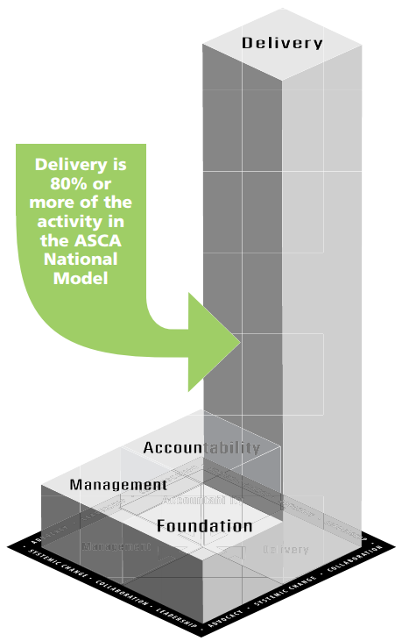
The National Model of School Counseling: Elements of Best Practices
School Counselors work within 3 domains of student development:
Academic, Social and Emotional, College and Career Readiness
Foundation – WHY we do what we do
e.g., setting annual goals, aligning work to standards, compliance to statutes/policies
Management – HOW we do what we do
e.g., needs assessments, setting expectations, analyzing data
Delivery – what we DO
e.g., individual student planning, delivering core counseling curriculum, responsive services, collaboration, consultation, referrals
Accountability – the IMPACT of what we do
e.g., program and professional evaluations, impact analyses
Source for graphic and more information: http://schoolcounselor.org/asca/media/asca/ASCA%20National%20Model%20Templates/ANMExecSumm.pdf

Slide 3
Foundations
School Counseling Philosophy
Beliefs, Vision Statement, and Mission Statement
School Counseling Guidelines
T.C.A., State Board of Education policy, Student Standards, Professional School Counselor Competencies, and Ethical Standards
Program Expectations
Budget, Resources, Responsibilities, and Use of Time
Program Goals
Student outcomes, Data-driven, and support School Improvement Plan
Notes:
How have/are you developing these pieces of your program? How many have a mission statement? Do other stakeholders know your mission statement? How many have clear expectations of the counseling program – who else helped develop those? Did you set a goal for your program this year? What kind of goal – SMART or general? Did you meet it? Did you communicate that progress with any stakeholder?
Foundations gets at the WHY we do what we do. What do we believe about students, what do we believe about school counseling, what do we believe about our ability to impact our students’ lives.
We have started conversations about revising both TCA and State Board policies to reflect school counseling as it is now and where it is going…transformed school counseling.
ASCA is revising the school counselor competencies so we will include those when they are released.

Slide 4
Management
Data
Use of data
School data profile
Program results data
Assessments
School and student needs assessments
School counselor competencies assessment
School counseling program audit
Use of time assessment
Tools
Program Management agreements
Advisory councils
Closing the gap action plans
Lesson plans
Calendars
Notes:
This is really the HOW of our work – how are we going to get it all done. How are we going to ensure all students benefit from our counseling program, etc.
Use of time assessment: How are counselors spending their time in terms of the expectations of the model: Foundations, Management, & Accountability should be no more than 20% of counselor time. Delivery of services should be at least 80% of time. We are a long way from there but we will get much closer – one step at a time.
We will collect examples and templates of these tools to have available for all counselors on the counselor resource page of CollegeforTN.org
Please send good tools to School.Counseling@tn.gov

Slide 5
Delivery of Services
Direct Services
Student Support
Delivery of Services
Work with Students
Work on behalf of Students

Slide 6
Delivery of Services
Direct Student Services
School counseling core curriculum
Individual student planning
Responsive services
Student Support Services
Consultations
Collaborations
Referrals
80% of the school counselor’s time should be spent providing direct and student support services.
Notes:
This is the WHAT of our work – what are we going to do? What services/programs are we going to provide?
This is broken into 2 categories – direct and indirect student services. We are intentionally calling the “indirect” student services, Student Support services. Often the work “indirect” implies the “everything else and the kitchen sink”. We want to communicate that these are the services we are providing on behalf of the student.
Direct student services – those programs/activities/etc. where we are in direct contact with the student.
School counselor core curriculum – both classroom and large group activities/programs
Individual student planning – advisement and appraisal
Responsive services – Individual and group counseling and crisis services. Crisis services aren’t just around death and loss. For a family that needs food assistance, helping them access those services (food bags), for the middle school girl whose boyfriend just broke up with her, etc.
Student support services include consultations and collaborations with a variety of stakeholders. Referrals-connecting families/students to community resources

Slide 7
Delivery of Services
School counseling core curriculum
Instruction: School counselors provide, facilitate, and coordinate instruction of the counseling core curriculum at the classroom, grade, and schoolwide level.
Group Activities\Experiences: School counselors conduct planned activities outside the classroom to promote academic achievement, social and emotional development, and college and career readiness.
Character education
Decision making
Bullying prevention
Career exploration
Career fairs
Postsecondary site visits
Leadership workshops
Community/ Business Tours
Notes:
This is the WHAT of our work – what are we going to do? What services/programs are we going to provide?
This is broken into 2 categories – direct and indirect student services. We are intentionally calling the “indirect” student services, Student Support services. Often the work “indirect” implies the “everything else and the kitchen sink”. We want to communicate that these are the services we are providing on behalf of the student.
Direct student services – those programs/activities/etc. where we are in direct contact with the student.
School counselor core curriculum – both classroom and large group activities/programs
Individual student planning – advisement and appraisal
Responsive services – Individual and group counseling and crisis services. Crisis services aren’t just around death and loss. For a family that needs food assistance, helping them access those services (food bags), for the middle school girl whose boyfriend just broke up with her, etc.
Student support services include consultations and collaborations with a variety of stakeholders. Referrals-connecting families/students to community resources

Slide 8
Delivery of Services
Individual Student Planning
Appraisal: School counselors assist students in analyzing and evaluating abilities, interests, skills, and achievement.
Advisement: School counselors assist students in establishing goals and future plans based upon academic, career, and personal/social data.
Data Chats
Achievement Interpretation
Interest Inventories
EPSO Coursework
Personal Goals
Postsecondary plans
Intervention Plans
Behavior Plans

Slide 9
Delivery of Services
Responsive Services
Short-term Counseling: School counselors provide short-term counseling to build students’ capacity to use appropriate coping skills, exercise self-advocacy, and solve problems.
Crisis Response: School counselors provide intervention and follow-up services to students facing emergency situations that could interrupt their learning.
Individual Counseling
Group Counseling
Standards Mastery
Death of a loved one
Homelessness
Abuse or Neglect
Suicidal Ideation
Notes:
This is the WHAT of our work – what are we going to do? What services/programs are we going to provide?
This is broken into 2 categories – direct and indirect student services. We are intentionally calling the “indirect” student services, Student Support services. Often the work “indirect” implies the “everything else and the kitchen sink”. We want to communicate that these are the services we are providing on behalf of the student.
Direct student services – those programs/activities/etc. where we are in direct contact with the student.
School counselor core curriculum – both classroom and large group activities/programs
Individual student planning – advisement and appraisal
Responsive services – Individual and group counseling and crisis services. Crisis services aren’t just around death and loss. For a family that needs food assistance, helping them access those services (food bags), for the middle school girl whose boyfriend just broke up with her, etc.
Student support services include consultations and collaborations with a variety of stakeholders. Referrals-connecting families/students to community resources

Slide 10
Delivery of Services
Referrals could be for academic, personal/social, and postsecondary/transition support.
Student Support Services
Referrals
Consultation
Collaboration
Collaboration with educators, parents, and community members to support student achievement.
Consultations with educators, parents, and community members to identify strategies to assist students and their families.
Notes:
This is the WHAT of our work – what are we going to do? What services/programs are we going to provide?
This is broken into 2 categories – direct and indirect student services. We are intentionally calling the “indirect” student services, Student Support services. Often the work “indirect” implies the “everything else and the kitchen sink”. We want to communicate that these are the services we are providing on behalf of the student.
Direct student services – those programs/activities/etc. where we are in direct contact with the student.
School counselor core curriculum – both classroom and large group activities/programs
Individual student planning – advisement and appraisal
Responsive services – Individual and group counseling and crisis services. Crisis services aren’t just around death and loss. For a family that needs food assistance, helping them access those services (food bags), for the middle school girl whose boyfriend just broke up with her, etc.
Student support services include consultations and collaborations with a variety of stakeholders. Referrals-connecting families/students to community resources

Slide 11
Delivery of Services
How do you determine which service to provide?
Need | Service Strategy
1. Ensure students can compare and contrast healthy and unhealthy behaviors. | DS: Curriculum: Instruction
2. Assist students in developing a postsecondary plan. | DS: Curriculum: Instruction ISP: Advisement
3. Teach organizational skills to a group of 4th grade boys who are ADHD. | DS: Responsive Services: Group Counseling
4. Plan a career fair. | DS: Curriculum: Group Experiences
5. Assist 504 team in writing an accommodation plan for a student. | DS: ISP: Appraisal/Advisement
6. Following a tornado in the school community, talk with local mental health center to get ideas to help students feel safe at school again. | SS: Consultation DS: Responsive Services
7. Serve on district team to increase the number of students participating in early postsecondary opportunities. | SS: Collaboration
8. Share information about the local housing authority to a single mother that recently lost housing. Provide students with food backpacks each Friday. | SS: Referrals DS: Crisis Response

Slide 12
Delivery of Services
School Counseling Standards
Prepared & Ready for PS
Knowledge
Skills
Experiences
Attitudes

Slide 13
Delivery of Services
School Counseling Standards
K-2
3-5
6-8
9-12
Grade bands allow for counselors to meet the development abilities of students. Standards should be taught and assessed at least one time within each grade band.

Slide 14
Delivery of Services
School Counseling Standards
Review Needs Assessment Identify standards aligned to needs
Identify aligned standards Find overlapped standards
Determine effective delivery methods
Determine student indicators
The Resource Guide will contain various examples of how to effectively address school counseling standards.

Slide 15
Accountability
Data Analysis
School data profile analysis
Use of time analysis
Program Audit analysis
Program Results
Curriculum results analysis
Small group results analysis
Closing the gap results analysis
Evaluation and Improvement
School counselor competencies analysis
Program evaluation analysis
School counselor professional evaluation
Notes:
This is the IMPACT of our work- how do we know what we do is working. Accountability helps to identify what’s working and where we have opportunities for growth.
Data is a critical part of the transformed school counselor’s program. It should help us to identify gaps and areas that need attention. It should drive our work. And it should help to show the impact and value of that work. We must both analyze and share the evaluation data from our program, both in part and in whole.
Accountability also includes the professional evaluation.
Once we have set new expectations for school counselors with the model and standards revision as well as the other work (TCA, State Board) we will then be positioned to look at the professional evaluation.

Slide 16
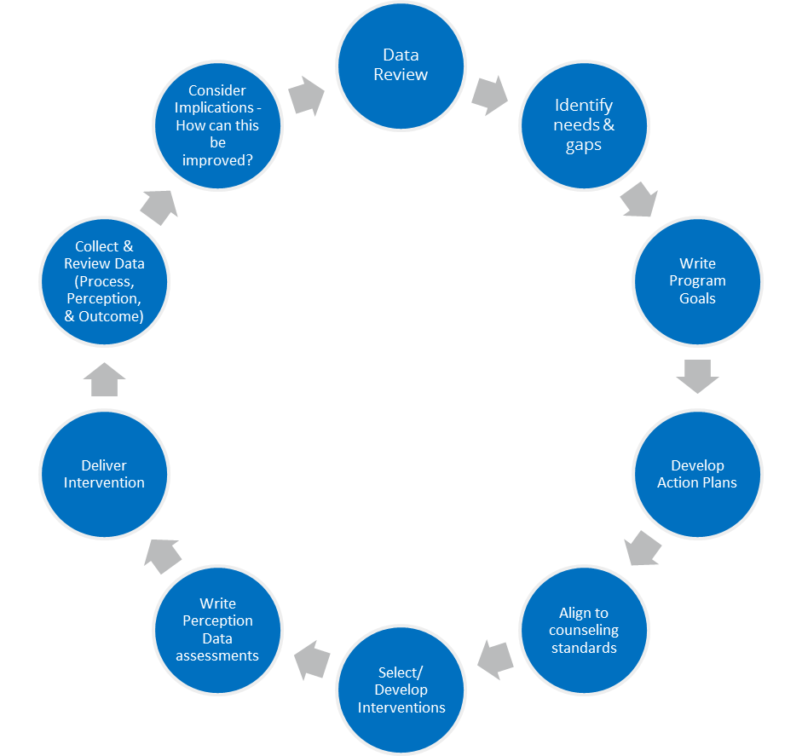
Accountability: Data Analysis
Notes:
This is the IMPACT of our work- how do we know what we do is working. Accountability helps to identify what’s working and where we have opportunities for growth.
Data is a critical part of the transformed school counselor’s program. It should help us to identify gaps and areas that need attention. It should drive our work. And it should help to show the impact and value of that work. We must both analyze and share the evaluation data from our program, both in part and in whole.
Accountability also includes the professional evaluation.
Once we have set new expectations for school counselors with the model and standards revision as well as the other work (TCA, State Board) we will then be positioned to look at the professional evaluation.

Slide 17
Accountability: Data Analysis
Use of time analysis
Use of time should reflect totality of the counseling program
Compare use of time to 80/20 recommendation
Review effectiveness of time spent on activities
Consider changing delivery methods to increase effectiveness or decrease time spent on the activity (without impacting effectiveness)
Notes:
This is the IMPACT of our work- how do we know what we do is working. Accountability helps to identify what’s working and where we have opportunities for growth.
Data is a critical part of the transformed school counselor’s program. It should help us to identify gaps and areas that need attention. It should drive our work. And it should help to show the impact and value of that work. We must both analyze and share the evaluation data from our program, both in part and in whole.
Accountability also includes the professional evaluation.
Once we have set new expectations for school counselors with the model and standards revision as well as the other work (TCA, State Board) we will then be positioned to look at the professional evaluation.

Slide 18
Accountability: Data Analysis
Program Audit:
Focus on the structure of the counseling program.
Consider each of the 4 program components
Answers the question “How well am I implementing the counseling model?”
Collect evidence of program implementation
Management agreements
Needs assessments
Calendars
Action plans
Program goals
Drive future implementation goals

Slide 19
Accountability: Program Results
Curriculum Results Report:
Demonstrates effectiveness of program and classroom activities
Grade Level | Lesson Topic | Projected Start/End | Process Data (Number of students affected) | Perception Data (Data from surveys/ assessments) | Outcome Data (Achievement, attendance and/or behavior data) | Implications
6th | Conflict Resolution | Oct. – Nov. | 399 6th grade students | Pre- & post-tests completed by random sample of students results: Believe that they can stop bullying – Pre-8% Post-63% Increase 687% Able to define bullying – Pre-11% Post-71% Increase 545% Able to identify one appropriate action when witnessing bullying – Pre-43% Post-72% Increase 112% | In 2016-17 the number of students with discipline referrals for “fighting” and “physical aggression” decreased from 22 students in first 9 weeks to 12 students in second 9 weeks. | The data indicate that the lesson had a positive impact in both perception and outcome data. Knowing this it may be beneficial to deliver these lessons earlier in the school year.
Notes:
This is the IMPACT of our work- how do we know what we do is working. Accountability helps to identify what’s working and where we have opportunities for growth.
Data is a critical part of the transformed school counselor’s program. It should help us to identify gaps and areas that need attention. It should drive our work. And it should help to show the impact and value of that work. We must both analyze and share the evaluation data from our program, both in part and in whole.
Accountability also includes the professional evaluation.
Once we have set new expectations for school counselors with the model and standards revision as well as the other work (TCA, State Board) we will then be positioned to look at the professional evaluation.

Slide 20
Accountability: Program Results
Small Group Results Report:
Demonstrates effectiveness of small group counseling
Grade Level | Lesson Topic | Projected Start/End | Process Data (Number of students affected) | Perception Data (Data from surveys/ assessments) | Outcome Data (Achievement, attendance and/or behavior data) | Implications
6th | Conflict Resolution | Oct. – Nov. | 399 6th grade students | Pre- & post-tests completed by random sample of students results: Believe that they can stop bullying – Pre-8% Post-63% Increase 687% Able to define bullying – Pre-11% Post-71% Increase 545% Able to identify one appropriate action when witnessing bullying – Pre-43% Post-72% Increase 112% | In 2016-17 the number of students with discipline referrals for “fighting” and “physical aggression” decreased from 22 students in first 9 weeks to 12 students in second 9 weeks. | The data indicate that the lesson had a positive impact in both perception and outcome data. Knowing this it may be beneficial to deliver these lessons earlier in the school year.
Notes:
This is the IMPACT of our work- how do we know what we do is working. Accountability helps to identify what’s working and where we have opportunities for growth.
Data is a critical part of the transformed school counselor’s program. It should help us to identify gaps and areas that need attention. It should drive our work. And it should help to show the impact and value of that work. We must both analyze and share the evaluation data from our program, both in part and in whole.
Accountability also includes the professional evaluation.
Once we have set new expectations for school counselors with the model and standards revision as well as the other work (TCA, State Board) we will then be positioned to look at the professional evaluation.

Slide 21
Accountability: Results Reports
Closing the Gap Results Report:
Reviews programming designed to promote equity in access and achievement
Activities | School Counseling Standards | Projected Start/End | Process Data (Number of students affected) | Perception Data (Data from surveys/ assessments) | Outcome Data (Achievement, attendance and/or behavior data) | Implications
Small group for study skills Peer tutoring Cultural awareness faculty presentation Teacher and parent consultations |  | Oct. 2015-April 2016 | 9 students 113 daily session during morning arrival | Pre/Post Student survey: How confident are you in math? Pre: 1 Post: 3.5 All students were able to name one strategy for improving in math. 4 students could name two and 1 student could name three. All students were able to name at least one person who could help them with math. | Comparison of 4th nine weeks math grade averages: 66% increased their math grade 2 students’ grade remained the same. 1 student’s grade decreased but was referred for additional support. | While math fluency increased it did not translate to significant grade changes. Students and teachers reported increased confidence levels. Because not all students viewed their homeroom teacher as someone who could help, additional staff development on multicultural issues and intervention strategies for language learners may be needed. A clearly defined exit procedure is needed to allow more students to participate in the intervention.
Notes:
After the reports are created, a careful analysis of the results of each report should be conducted. When reviewing the data, school counselors should address the following questions:
Did the choice of curriculum/activities support the learning goals?
What can be learned from reviewing the process/perception/outcome data?
What are the implications of recommendations?

Slide 22
Accountability: Evaluation & Improvement
School Counseling Program Evaluation
Qualitative and Quantitative Data
Stakeholder participation
Totality of counseling program
Review of student outcomes
Alignment to needs assessment results
Opportunities for program growth
School Counselor Competencies Assessment
Professional growth opportunities impact on effectiveness
Alignment to student outcomes
Notes:
This is the IMPACT of our work- how do we know what we do is working. Accountability helps to identify what’s working and where we have opportunities for growth.
Data is a critical part of the transformed school counselor’s program. It should help us to identify gaps and areas that need attention. It should drive our work. And it should help to show the impact and value of that work. We must both analyze and share the evaluation data from our program, both in part and in whole.
Accountability also includes the professional evaluation.
Once we have set new expectations for school counselors with the model and standards revision as well as the other work (TCA, State Board) we will then be positioned to look at the professional evaluation.

Slide 23
Accountability: Evaluation & Improvement
School counselor professional evaluation
Improve practice
School Services Personnel Rubric (TEAM)
Includes all areas of the counseling program
Observations are conversations between the school counselor and evaluator
All observations are announced
It aligns expectations of the model to the rubric
Notes:
This is the IMPACT of our work- how do we know what we do is working. Accountability helps to identify what’s working and where we have opportunities for growth.
Data is a critical part of the transformed school counselor’s program. It should help us to identify gaps and areas that need attention. It should drive our work. And it should help to show the impact and value of that work. We must both analyze and share the evaluation data from our program, both in part and in whole.
Accountability also includes the professional evaluation.
Once we have set new expectations for school counselors with the model and standards revision as well as the other work (TCA, State Board) we will then be positioned to look at the professional evaluation.

Slide 24
Questions

Slide 25
Next Steps
Release of Implementation Guide and Timeline Checklist
Complete Program Audit
Watch for “Save the Dates” for additional professional development

Slide 26
Contact
Leigh Bagwell
Coordinator of School Counseling
College, Career and Technical Education
Leigh.Bagwell@tn.gov
School.Counseling@tn.gov
(615) 418-4527

