Slide 1
TEnnCARE
Council on Autism Spectrum Disorder April 24, 2018 Update

Slide 2
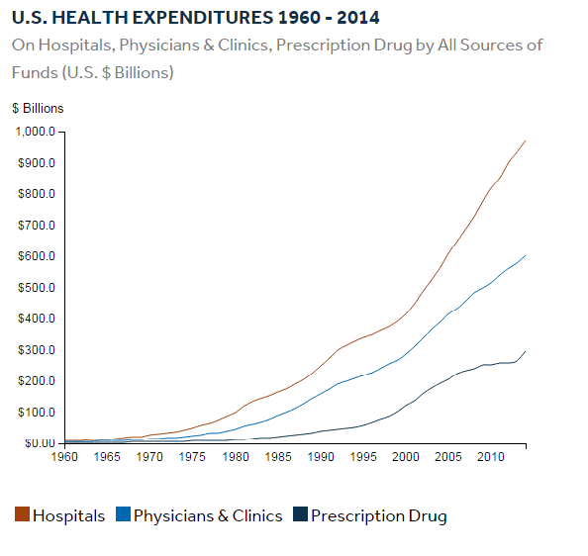
Healthcare costs are increasing steadily
Healthcare costs continue to grow at a faster rate than inflation
Healthcare costs for a typical family of 4 have doubled in the last decade¹
In the private sector, this squeezes out opportunities for investment and profit
In government, healthcare costs soak up money that could be spent on other services such as education or safety.
¹ 2015 Milliman Medical Index

Slide 3
Tennessee Health Care Innovation Initiative
We are deeply committed to reforming the way that we pay for healthcare in Tennessee
Our goal is to pay for outcomes and for quality care, and to reward strongly performing providers
We plan to have value-based payment account for the majority of healthcare spend within the next three to five years
By aligning on common approaches we will see greater impact and ease the transition for providers
We appreciate that hospitals, medical providers, and payers have all demonstrated a sincere willingness to move toward payment reform
By working together, we can make significant progress toward sustainable medical costs and improving care

Slide 4
Tennessee’s Three Strategies
Strategy elements
Examples
Patient Centered Medical Homes
Tennessee Health Link for people with the highest behavioral health needs
Care coordination tool with hospital and ED admission provider alerts
Prevention
Maintaining health
Coordinating specialists
Avoiding preventable episodes of care
Connecting behavioral and primary care
Primary Care
Transformation
Perinatal
Joint replacement
Asthma exacerbation
Colonoscopy
Cholecystectomy
ADHD
Episodes of Care
75 Episodes of Care
Quality and acuity adjusted payments for LTSS services
Value-based purchasing for enhanced respiratory care
Workforce development
Payment for value and quality in nursing facilities and home and community based services
Training for providers
Long Term Services & Supports
Notes:
In Tennessee we are taking a leadership role in changing the incentives for providers so that better care and more efficient care is rewarded. These are our three strategies:
Primary Care Transformation includes patient centered medical home, which pays primary care providers for prevention, for maintaining a patient’s health over time, and for coordinating the care they receive from specialists. We have our Tennessee Health Link program as well, which is a value-based payment approach to paying for behavioral health care coordination.
The second strategy, Episodes are for acute and specialist-driven care, and we are on a path to design 75 episodes of care by 2020.
We also have several value-based payment approaches to long term services and support.

Slide 5
Objectives of PCMH and Tennessee Health Link
PCMH: Holistic approach to care coordination for all patients
Tennessee Health Link: Coordinated approach for highest-needs behavioral health members
Access
Ensure access to the full spectrum of needed care for all patients¹, including those with long-term services and supports needs
Ensure access to a range of behavioral-health related supports aligned with level of need
Joint decision making
Foster joint decision making across the continuum of care providers
Foster joint decision making across behavioral and other health providers
Mindsets
Instill awareness of quality, cost, and patient access across range of providers
Instill awareness of interaction of behavioral and physical health needs including quality and cost impact
Sources of value
Expected sources of value to include
Appropriateness of care setting²
Appropriateness of treatment³
Improved patient treatment compliance
Referrals to high-value providers
Reduced readmissions
Expected sources of value to include
Appropriateness of behavioral health care setting / forms of delivery
Choice of behavioral healthcare providers
Referrals to high-value providers
Medication management
Primary care transformation aims to enhance coordination and integration across behavioral and physical health
1 E.g., Extended office hours, open scheduling
2 E.g., Reduction in unnecessary ED visits and inpatient admissions; shift to lower cost facilities
3 E.g., Improved medical management, appropriate length of stay, effective resource utilization

Slide 6
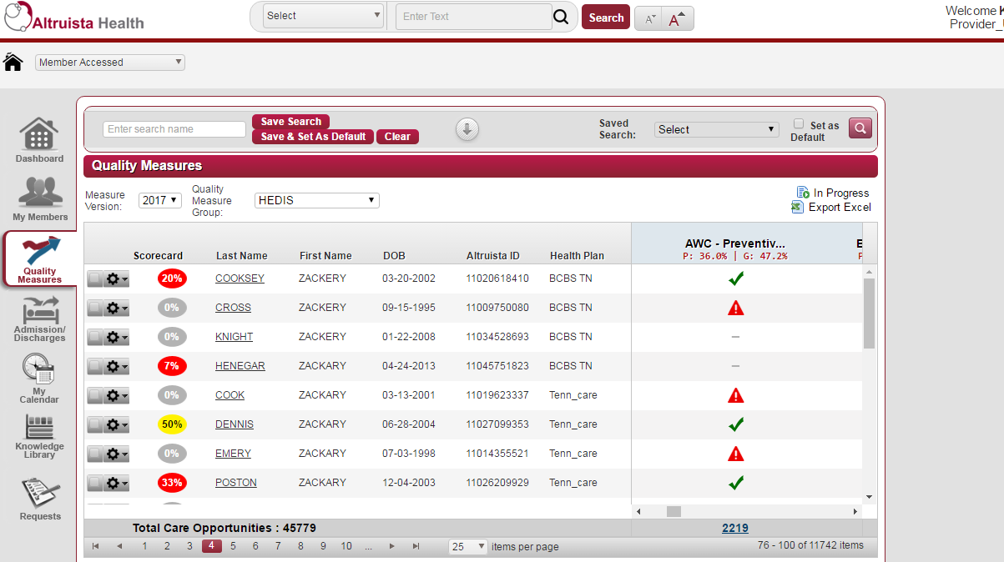
Care Coordination Tool
A multi-payer shared care coordination tool will allow primary care providers to implement better care coordination in their offices.
Hospital A
Payer A
Payer C
Allows practices to view their attributed member panel
Alerts providers of their attributed members’ hospital admissions, discharges, and transfers (ADT feeds) and tracks follow-up activities
Identifies a provider’s attributed members’ risk scores
Generates and displays gaps-in-care based on quality measures and tracks completion of activities
Hospital B
ADT feeds
Payer B
Hospital C
State
eHealth
connection
State
eHealth
connection
Hospital D
Hospital E
Claims data
& Attribution
Shared care coordination tool
Care coordination information
PCP
PCP
Tennessee Health Link
Tennessee Health Link
PCP
PCP

Slide 7
PCMH Payment Model Overview
Objective
Payment
Practice Transformation
Payment
$1 per member per month (PMPM) payment
Not risk adjusted
Each practice will receive this payment for their first year of participation
Support initial investment in practice transformation
Activity Payment
Support practices for the labor and time required to evolve their care delivery models. Practices may hire new staff (e.g., care coordinators) or change responsibilities for existing staff to support practice transformation.
Incentivize ongoing activity requirements
Risk-adjusted PMPM payment
Each PCMH will be assigned to a risk band based on the acuity of their membership
MCOs will set payment levels for these bands, but average payment across all practices will be $4 PMPM
Outcome
Payment
Encourage improvements in total-cost-of care and clinical outcomes
Reward high quality providers
Annual bonus payment available to high performing PCMHs
High-volume (5,000+ member) PCMH practices: Shared savings based on total cost of care and quality metrics
Low-volume (<5,000 member) PCMH practices: Bonus payment based on efficiency and quality metrics
Payments in addition to the base primary care payments such as FFS

Slide 8
75 episodes of care will be designed and implemented over 5 years
Design year & wave
Episode
Design year & wave
Design year & wave
Episode
Episode
2013
1
Perinatal
2016
6
Skin and soft tissue infections
2018
9
Conduct disorder
Asthma acute exacerbation
Neonatal (Age 31 weeks or less)
Lung cancer (multiple)
Total joint replacement
Neonatal (Age 32 to 36 weeks)
Colon cancer
2014
2
Neonatal (Age 37 weeks or greater)
Female reproductive cancer
COPD acute exacerbation
Liver & pancreatic cancer
Colonoscopy
HIV
Cholecystectomy
Pancreatitis
Drug dependence
PCI - acute
Diabetes acute exacerbation
10
Sickle cell
PCI – non acute
2017
7
Spinal fusion
Renal failure
2015
3
GI hemorrhage
Spinal decompression (without spinal fusion)
Other major bowel (multiple)
EGD
Hepatitis C
Respiratory Infection
Femur / pelvic fracture
Knee arthroscopy
GERD acute exacerbation
Pneumonia
Kidney & urinary tract stones
UTI - outpatient
Ankle non-operative injuries
UTI – inpatient
Wrist non-operative injuries
Hemophilia & other coag. dis.
4
ADHD
Shoulder non-operative injuries
Rheumatoid arthritis
CHF acute exacerbation
Knee non-operative injuries
2019
11
Schizophrenia (multiple)
ODD
Back / Neck pain
Bipolar - chronic
CABG
8
Acute Seizure
Bipolar – acute exacerbation
Valve repair and replacement
Syncope
Bariatric surgery
Hyponatremia/dehydration
PTSD
2016
5
Breast biopsy
Pediatric acute lower respiratory infection
Anal procedures
Breast cancer, medical oncology
CAD & angina
Breast cancer, Mastectomy
Colposcopy
Cardiac arrhythmia
Otitis media
Hysterectomy
Depression – acute exacerbation
Tonsillectomy
GI obstruction
Non-emergent depression
Appendectomy
Pacemaker / Defibrillator
Anxiety
Hernia procedures
Dermatitis / Urticaria
Updated June 20, 2017

Slide 9
Episodes estimated savings for 2015 is approximately
$10.8 million due to episodes’ risk adjusted cost being less than projected medical trend of a 3% annual increase
Comparison of Projected and Actual Avg. Risk-Adjusted Episode Cost, CY 2015
Episode Type | Projected | Actual | Estimated savings per Episode | Percent | Number of Valid Episodes | Total Estimated Savings
Total | - | - | - | - | 33,385 | $10,822,268
Perinatal | $6,893 | $6,469 | $425 | 6.2% | 20,442 | $8,684,619
Acute Asthma Exacerbation | $1,213 | $1,074 | $139 | 11.5% | 12,614 | $1,752,446
Total Joint Replacement | $12,481 | $11,310 | $1,171 | 9.4% | 329 | $385,203

Slide 10
Episodes estimated savings for 2016 is approximately
$14.5 million due to episodes’ risk adjusted cost being less than projected medical trend of a 3% annual increase
Comparison of Projected and Actual Avg. Risk-Adjusted Episode Cost, CY 2016
Episode Type | Projected | Actual | Estimated savings per Episode | Percent | Number of Valid Episodes | Total Estimated Savings
Total | - | - | - | - | 45,188 | $14,548,603
Perinatal | $7,100 | $6,598 | $502 | 7.1% | 22,090 | $11,065,302
Acute Asthma Exacerbation | $1,249 | $1,067 | $182 | 14.6% | 12,939 | $2,358,909
Total Joint Replacement | $12,855 | $11,878 | $977 | 7.6% | 460 | $449,608
Cholecystectomy | $4,653 | $4,591 | $61 | 1.3% | 2,110 | $129,452
Colonoscopy | $1,112 | $1,082 | $30 | 2.7% | 2,929 | $87,366
COPD | $2,390 | $2,253 | $136 | 5.7% | 4,116 | $561,376
Acute PCI | $9,376 | $9,284 | $92 | 1.0% | 416 | $38,279
Non-acute PCI | $6,926 | $8,033 | -$1,107 | -16.0% | 128 | -$141,689

Slide 11
Estimate of Penalties and Rewards, CY 2016, With One-Time Penalty Adjustment
Total TennCare: Blue Care, Amerigroup, and United
 | Rewards | Penalties | Balance
Perinatal | $777,731 | $359,947 | $417,784
Acute Asthma Exacerbation | $13,318 | $50,558 | ($37,240)
Total Joint Replacement | $5,556 | $29,513 | ($23,958)
Cholecystectomy | $22,735 | $25,997 | ($3,262)
Colonoscopy | $18,841 | $22,299 | ($3,458)
COPD | $55,552 | $7,285 | $48,267
Acute PCI | $27,989 | $37,720 | ($9,732)
Non-acute PCI | $15,171 | $9,072 | $6,098
Total | $936,893 | $542,393 | $394,500

Slide 12
Thank You
Questions? Email payment.reform@tn.gov
More information: http://www.tn.gov/hcfa/section/strategic-planning-and-innovation-group

